Slide 1
Bayes Factors for ANOVA
Greg Francis
PSY 626: Bayesian Statistics for Psychological Science
Spring 2024
Purdue University

Slide 2
Bayes Factor
Evidence for the alternative hypothesis (or the null) is computed with the Bayes Factor (BF)
BF>1 indicates that the data is evidence for the alternative, compared to the null
BF<1 indicates that the data is evidence for the null, compared to the alternative
Notes:
3/29/24
PSY200 Cognitive Psychology
2

Slide 3
JZS Priors on effect size
For the alternative, a good choice is a Cauchy distribution (t-distribution with df=1) Rouder et al. (2009)
Jeffreys, Zellner, Siow

Slide 4
JZS Priors
Scale parameter “r”
Bigger values make for a broader prior
  More flexibility!
  More penalty!

Slide 5
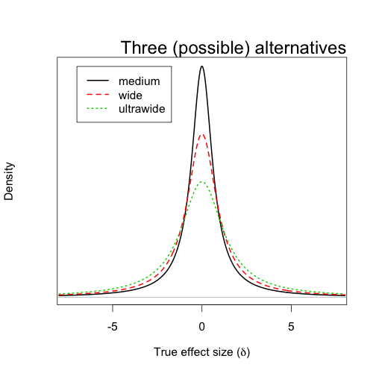
Variations of JZS Priors
Medium r= 1
Wide r= sqrt(2)/2
Ultrawide r=sqrt(2)

Slide 6
Meta-analytic Bayes Factor
How to pool information across experiments?
Meta-analysis: compute effect size compute pooled effect size (weighting by inverse variance)
  Fixed effect assumes a common standardized effect across experiments
Bayes Factor: suppose you just took the posterior for one experiment and used it as the prior for the next
  This might suggest you just multiply Bayes Factors (and some people have suggested to do that)
  But a bit of thought reveals this is not correct
Multiple small sample studies might each individually indicate support for the null hypothesis, even though they all are in a common direction
  A pooled effect size might indicate convincing support for the alternative hypothesis

Slide 7
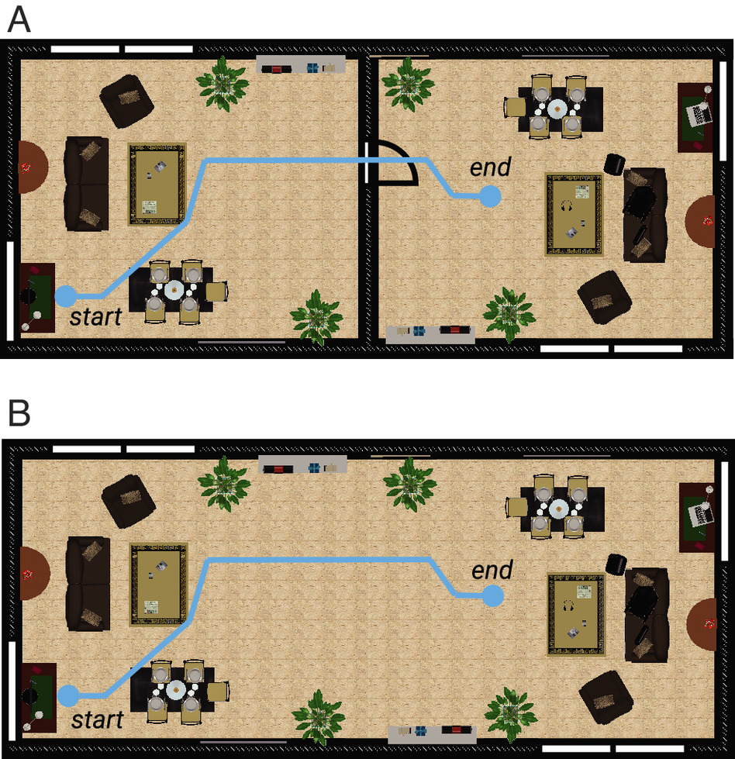

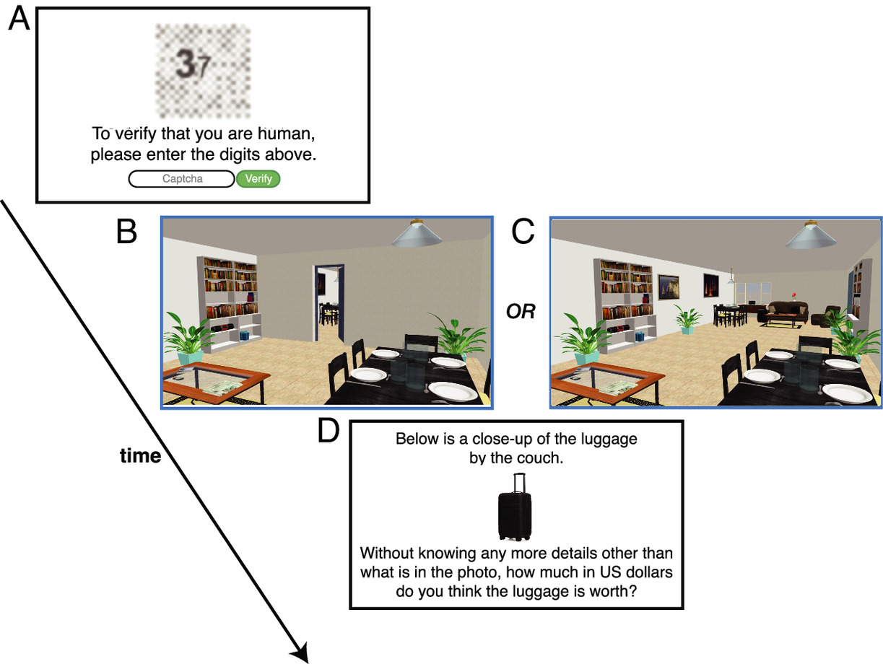
Meta-analytic Bayes Factor
Consider a recent paper on anchoring effects

Slide 8
Meta-analytic Bayes Factor
Seven (pre-registered) experiments all show an anchoring effect
  Significant t-test
  Significant interaction with doorway conditions
  Sadly, these results seem “too good to be true” (Francis, 2024)

Slide 9
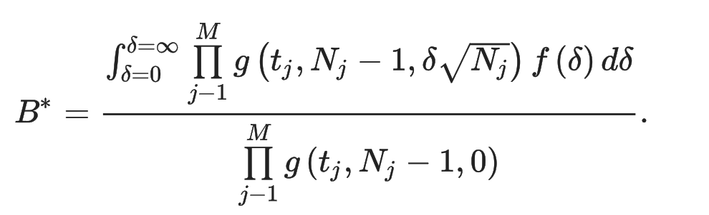
Meta-analytic Bayes Factor
Each of the first 6 studies provides only modest evidence for the alternative or null
The product of Bayes Factors is 0.456, which indicates anecdotal evidence for the null
  This calculation multiplies the integrals, but what we really want to do is integrate the products
> source("Metanalysis.R")
2.52 200 200 1.752224
2.32 200 200 1.095823
2.07 200 200 0.6427691
2.44 200 200 1.445722
2.03 200 200 0.5934476
2.03 400 400 0.4308029

Slide 10
Meta-analytic Bayes Factor
Each of the first 6 studies provides only modest evidence for the alternative or null
The integral of the product of density functions is 53155.67, which is overwhelming support for the alternative model
  Of course, you shouldn’t trust these results at all because they are not going to replicate with similar experiments
> source("Metanalysis.R")
2.52 200 200 1.752224
2.32 200 200 1.095823
2.07 200 200 0.6427691
2.44 200 200 1.445722
2.03 200 200 0.5934476
2.03 400 400 0.4308029
53155.67

Slide 11

Graphical interface
JASP (graphical interface)
  https://jasp-stats.org
  Free download, lots of tests
  Also supports frequentist analyses

Slide 12
ANOVA
Most widely used hypothesis test in the NHST framework
The Bayesian variation of ANOVA focuses (as it must) on model comparison
Standard ANOVA often does the same kind of thing
  In violation of controlling the Type I error rate
  If there is really no difference between means, a 2x2 ANOVA has a 14% chance of reporting a significant difference for at least one of:
    Main effect 1
    Main effect 2
    Interaction
  Add in various contrasts, and the Type I error rate is much higher!

Slide 13
Search of memory
How is memory searched?
Explore by varying the number of items in memory set
measure reaction time
  Sternberg (1969)
NO
5 3 2 9
5 3 2 9
5 3 2 9
8

Slide 14
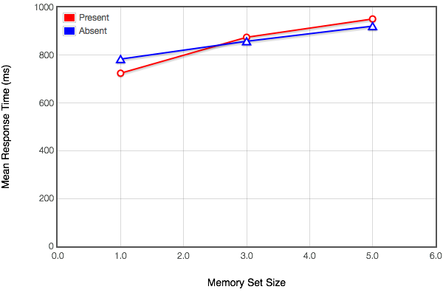
Search of memory
Typical results: Parallel curves for “present” and “absent” targets
Implications for how people search short term memory
Average of 107 participants

Slide 15
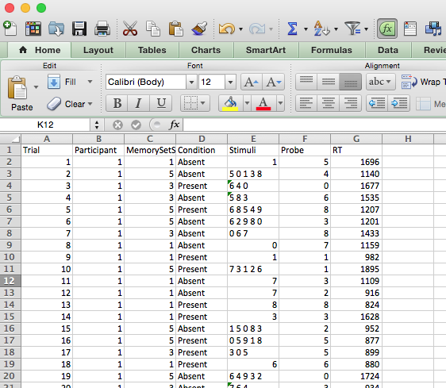
Mixed design ANOVA
Sternberg search experiment
113 participants

Slide 16
NHST
SSdata<-read.csv(file="SternbergSearch.csv",header=TRUE,stringsAsFactors=FALSE)
# Treat MemorySetSize as a factor
SSdata$MemorySetSize = factor(SSdata$MemorySetSize)
levels(SSdata$MemorySetSize) = c("Small", "Medium", "Large")
# Treat Condition as a factor
SSdata$Condition = factor(SSdata$Condition)
# Treat Participants as a factor
SSdata$Participant = factor(SSdata$Participant)
# NHST ANOVA
NHST <- aov(RT ~ Condition*MemorySetSize + Error(Participant/(Condition*MemorySetSize)), data=SSdata)
  print(summary(NHST))
  flush.console()
Error: Participant
Df Sum Sq Mean Sq F value Pr(>F)
Residuals 112 297873026 2659581
Error: Participant:Condition
Df Sum Sq Mean Sq F value Pr(>F)
Condition 1 441 441 0.003 0.954
Residuals 112 15105750 134873
Error: Participant:MemorySetSize
Df Sum Sq Mean Sq F value Pr(>F)
MemorySetSize 2 37548107 18774053 218.2 <2e-16 ***
Residuals 224 19269553 86025
---
Signif. codes: 0 ‘***’ 0.001 ‘**’ 0.01 ‘*’ 0.05 ‘.’ 0.1 ‘ ’ 1
Error: Participant:Condition:MemorySetSize
Df Sum Sq Mean Sq F value Pr(>F)
Condition:MemorySetSize 2 2221905 1110952 16.63 1.84e-07 ***
Residuals 224 14962110 66795
---
Signif. codes: 0 ‘***’ 0.001 ‘**’ 0.01 ‘*’ 0.05 ‘.’ 0.1 ‘ ’ 1
Error: Within
Df Sum Sq Mean Sq F value Pr(>F)
Residuals 6102 348154998 57056

Slide 17
BayesFactor
bf = anovaBF(RT ~ Condition*MemorySetSize + Participant, data=SSdata, whichRandom="Participant")
  summary(bf)
  flush.console()
Definitive evidence for model 4 (interaction) relative to the null
Definitive evidence for models 1 and 3 relative to the null
Definitive evidence for against model 2 (target present/absent) relative to the null
|=====================================================================================================================================| 100%
Bayes factor analysis
--------------
[1] MemorySetSize + Participant : 5.714551e+126 ±1.11%
[2] Condition + Participant : 0.0266815 ±0.99%
[3] MemorySetSize + Condition + Participant : 1.516253e+125 ±1.54%
[4] MemorySetSize + Condition + MemorySetSize:Condition + Participant : 5.509793e+130 ±5.44%
Against denominator:
RT ~ Participant
---
Bayes factor type: BFlinearModel, JZS

Slide 18
BayesFactor
What about comparing the different models against each other?
  Easy, just “divide”
Clearly favors the interaction model (different slopes)
> bf[4]/bf[1]
Bayes factor analysis
--------------
[1] MemorySetSize + Condition + MemorySetSize:Condition + Participant : 9641.691 ±5.56%
Against denominator:
RT ~ MemorySetSize + Participant
---
Bayes factor type: BFlinearModel, JZS
> bf[4]/bf[3]
Bayes factor analysis
--------------
[1] MemorySetSize + Condition + MemorySetSize:Condition + Participant : 363382.1 ±5.66%
Against denominator:
RT ~ MemorySetSize + Condition + Participant
---
Bayes factor type: BFlinearModel, JZS

Slide 19
BayesFactor
The calculations are are kind of like for Stan/ulam()
  Monte Carlo sampling
So, you will get different answers for different “runs” of the code
Quantitative differences in the calculated BF
newbf = recompute(bf, iterations = 500000)
summary(newbf)
flush.console()
Bayes factor analysis
--------------
[1] MemorySetSize + Participant : 5.613838e+126 ±0.18%
[2] Condition + Participant : 0.02708769 ±0.23%
[3] MemorySetSize + Condition + Participant : 1.53574e+125 ±0.87%
[4] MemorySetSize + Condition + MemorySetSize:Condition + Participant : 5.246015e+130 ±0.82%
Against denominator:
RT ~ Participant
---
Bayes factor type: BFlinearModel, JZS

Slide 20
More models
bf2 = anovaBF(RT ~ Condition*MemorySetSize + Participant, data=SSdata, whichRandom="Participant", whichModels="all", iterations=500000)
Definitive evidence for model 5 (set size and interaction) relative to the null [Matches ANOVA!]
Definitive evidence for models 1, 3, 4, 6, and 7 relative to the null
Strong evidence against model 2 (target present/absent) relative to the null
> bf2
Bayes factor analysis
--------------
[1] MemorySetSize + Participant : 5.648325e+126 ±0.27%
[2] Condition + Participant : 0.02713646 ±0.26%
[3] MemorySetSize:Condition + Participant : 69963.9 ±0.21%
[4] MemorySetSize + Condition + Participant : 1.535721e+125 ±0.46%
[5] MemorySetSize + MemorySetSize:Condition + Participant : 1.930852e+132 ±1.27%
[6] Condition + MemorySetSize:Condition + Participant : 1917.212 ±0.86%
[7] MemorySetSize + Condition + MemorySetSize:Condition + Participant : 5.218889e+130 ±0.51%
Against denominator:
RT ~ Participant

Slide 21
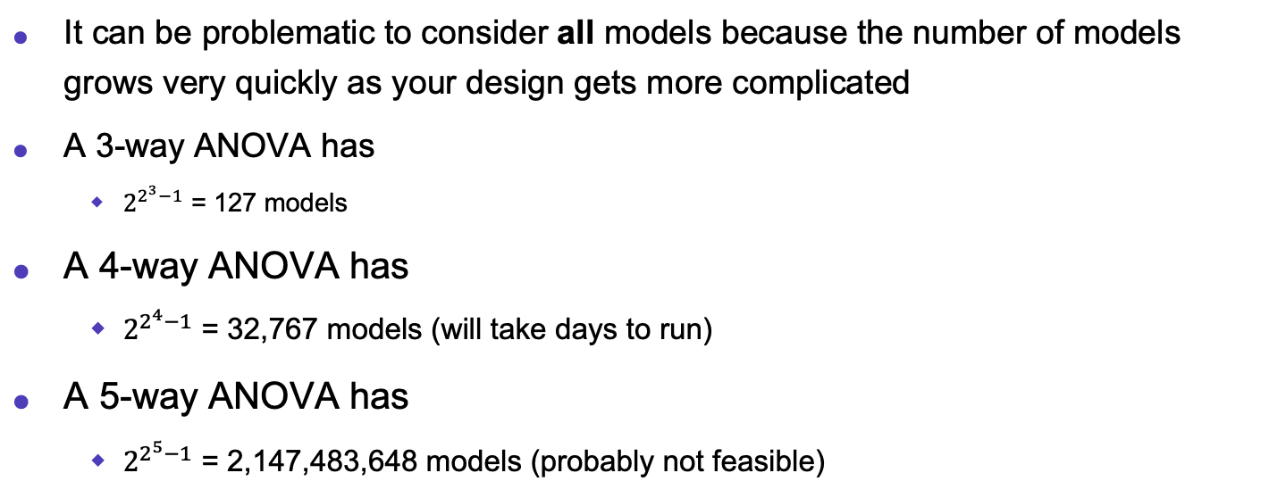
More models
It can be problematic to consider all models because the number of models grows very quickly as your design gets more complicated
A 3-way ANOVA has
  $2^{2^{3}−1}$ = 127 models
A 4-way ANOVA has
  $2^{2^{4}−1}$ = 32,767 models (will take days to run)
A 5-way ANOVA has
  $2^{2^{5}−1}$ = 2,147,483,648 models (probably not feasible)

Slide 22
More models
Can focus on most complex model and slightly less complex:
anovaBF(RT ~ Condition*MemorySetSize + Participant, whichRandom="Participant", data=SSdata, whichModels="top")
Substantial evidence for model 2 (set and interaction) relative to the full model
Definitive evidence against other models relative to the full
Bayes factor top-down analysis
--------------
When effect is omitted from MemorySetSize + Condition + MemorySetSize:Condition + Participant , BF is...
[1] Omit Condition:MemorySetSize : 2.841372e-06 ±4.72%
[2] Omit Condition : 35.57535 ±5.14%
[3] Omit MemorySetSize : 3.350643e-128 ±3.93%
Against denominator:
RT ~ MemorySetSize + Condition + MemorySetSize:Condition + Participant
---
Bayes factor type: BFlinearModel, JZS

Slide 23
More models
Can focus on most simple model and slightly more complex:
anovaBF(RT ~ Condition*MemorySetSize + Participant, whichRandom="Participant", data=SSdata, whichModels="bottom")
Decisive evidence for model 1 (set) relative to the null model
Strong evidence for model 3 (interaction) relative to the null
Strong evidence against model 2 (present/absent) relative to the null
Bayes factor analysis
--------------
[1] MemorySetSize + Participant : 5.678792e+126 ±1.21%
[2] Condition + Participant : 0.02732701 ±2.3%
[3] MemorySetSize:Condition + Participant : 68469.9 ±0.6%
Against denominator:
RT ~ Participant
---
Bayes factor type: BFlinearModel, JZS

Slide 24
Rethinking
Null model has different intercepts for each participant
  Ulam would not converge, so I am using quap
SSdataNull <- data.frame(RT= SSdata$RT, Participant=SSdata$Participant)
SSmodelNull <- quap(
alist( RT ~ dnorm(mu, sigma),
mu <- a[Participant],
a[Participant] ~ dnorm(1000, 200),
sigma ~ dunif(0, 1000)
), data= SSdataNull )

Slide 25
Rethinking
Model with intercept and slope for Memory Set Size (with shrinkage)
SSdataMSS <- data.frame(RT= SSdata$RT, MemorySetSize=SSdata$MemorySetSize, Participant=SSdata$Participant)
SSmodelMSS <- quap(
alist( RT ~ dnorm(mu, sigma),
mu <- a[Participant] + b[Participant]*MemorySetSize,
a[Participant] ~ dnorm(1000, 200),
b[Participant] ~ dnorm(0, 100),
sigma ~ dunif(0, 1000)
), data= SSdataMSS )

Slide 26
Rethinking
Model with intercept and slope for Target condition (with shrinkage)
SSdataCondition <- data.frame(RT= SSdata$RT, Condition=SSdata$TargetPresent, Participant=SSdata$Participant)
SSmodelCondition <- quap(
alist( RT ~ dnorm(mu, sigma),
mu <- a[Participant] + b[Participant]*Condition,
a[Participant] ~ dnorm(1000, 200),
b[Participant] ~ dnorm(0, 100),
sigma ~ dunif(0, 1000)
), data= SSdataCondition )

Slide 27
Rethinking
Additive model (with shrinkage)
SSdataAdditive <- data.frame(RT= SSdata$RT, Condition=SSdata$TargetPresent, MemorySetSize=SSdata$MemorySetSize, Participant=SSdata$Participant)
SSmodelAdditive <- quap(
alist( RT ~ dnorm(mu, sigma),
mu <- a[Participant] + b[Participant]*MemorySetSize + c[Participant]*Condition,
a[Participant] ~ dnorm(1000, 200),
b[Participant] ~ dnorm(0, 100),
c[Participant] ~ dnorm(0, 100),
sigma ~ dunif(0, 1000)
), data= SSdataAdditive )

Slide 28
Rethinking
Additive model and interaction
SSdataInteraction <- data.frame(RT= SSdata$RT, Condition=SSdata$TargetPresent, MemorySetSize=SSdata$MemorySetSize, Participant=SSdata$Participant)
SSmodelInteraction <- quap(
alist( RT ~ dnorm(mu, sigma),
mu <- a[Participant] + b[Participant]*MemorySetSize + c[Participant]*Condition+ d[Participant]*MemorySetSize*Condition,
a[Participant] ~ dnorm(1000, 200),
b[Participant] ~ dnorm(0, 100),
c[Participant] ~ dnorm(0, 100),
d[Participant] ~ dnorm(0, 100),
sigma ~ dunif(0, 1000)
), data= SSdataInteraction )

Slide 29
Rethinking
Interaction only (and intercept) (with shrinkage)
SSdataInteraction <- data.frame(RT= SSdata$RT, Condition=SSdata$TargetPresent, MemorySetSize=SSdata$MemorySetSize, Participant=SSdata$Participant)
SSmodelInteractionOnly <- quap(
alist( RT ~ dnorm(mu, sigma),
mu <- a[Participant] + d[Participant]*MemorySetSize*Condition,
a[Participant] ~ dnorm(1000, 200),
d[Participant] ~ dnorm(0, 100),
sigma ~ dunif(0, 1000)
), data= SSdataInteraction )

Slide 30
Rethinking
Memory Set Size and Interaction (and intercept) (with shrinkage)
SSdataInteraction <- data.frame(RT= SSdata$RT, Condition=SSdata$TargetPresent, MemorySetSize=SSdata$MemorySetSize, Participant=SSdata$Participant)
SSmodelInteractionMMS <- quap(
alist( RT ~ dnorm(mu, sigma),
mu <- a[Participant] + b[Participant]*MemorySetSize + d[Participant]*MemorySetSize*Condition,
a[Participant] ~ dnorm(1000, 200),
b[Participant] ~ dnorm(0, 100),
d[Participant] ~ dnorm(0, 100),
sigma ~ dunif(0, 1000)
), data= SSdataInteraction )

Slide 31
Rethinking
Target Condition and Interaction (and intercept)
SSdataInteraction <- data.frame(RT= SSdata$RT, Condition=SSdata$TargetPresent, MemorySetSize=SSdata$MemorySetSize, Participant=SSdata$Participant)
SSmodelInteractionCondition <- quap(
alist( RT ~ dnorm(mu, sigma),
mu <- a[Participant] + c[Participant]*Condition+ d[Participant]*MemorySetSize*Condition,
a[Participant] ~ dnorm(1000, 200),
c[Participant] ~ dnorm(0, 100),
d[Participant] ~ dnorm(0, 100),
sigma ~ dunif(0, 1000)
), data= SSdataInteraction )

Slide 32
Model comparison
> bf2
Bayes factor analysis
--------------
[1] MemorySetSize + Participant : 5.519399e+126 ±0.59%
[2] Condition + Participant : 0.02776611 ±1.88%
[3] MemorySetSize:Condition + Participant : 70932.28 ±1.18%
[4] MemorySetSize + Condition + Participant : 1.518957e+125 ±2.36%
[5] MemorySetSize + MemorySetSize:Condition + Participant : 1.910749e+132 ±1.23%
[6] Condition + MemorySetSize:Condition + Participant : 2186.301 ±14.32%
[7] MemorySetSize + Condition + MemorySetSize:Condition + Participant : 5.138857e+130 ±1.94%
Against denominator:
RT ~ Participant
---
Bayes factor type: BFlinearModel, JZS
compare(SSmodelInteractionCondition, SSmodelInteractionMMS, SSmodelInteractionOnly, SSmodelAdditive , SSmodelCondition, SSmodelMSS, SSmodelNull)
WAIC SE dWAIC dSE pWAIC weight
SSmodelAdditive 93929.7 182.07 0.0 NA 306.8 1
SSmodelInteraction 93955.0 184.50 25.4 20.37 381.2 0
SSmodelInteractionMMS 93984.4 182.29 54.7 21.96 335.0 0
SSmodelMSS 93999.2 177.70 69.5 27.13 221.2 0
SSmodelInteractionCondition 94164.2 178.30 234.6 43.92 290.9 0
SSmodelInteractionOnly 94403.0 172.88 473.4 54.32 226.0 0
SSmodelCondition 94507.9 169.30 578.2 53.93 194.5 0
SSmodelNull 94554.2 165.98 624.5 59.30 112.4 0

Slide 33
Model comparison
The BayesFactor ANOVA is a pretty easy way to generate/compare “standard” models
  Main effects, interactions
It would be nice if it gave similar conclusions about these types of models as the WAIC analyses
  But we shouldn’t really expect that because they attempt to answer different questions
The BayesFactor ANOVA is not very good at comparing “non-standard” models
Historically, for the Sternberg search task, non-standard models are what we should compare

Slide 34
Search of memory
How is memory searched?
  Sternberg hypothesized three types of searches
Explore by varying the number of items in memory set (similar to visual search experiments)
  measure reaction time
  Sternberg (1969)
NO
5 3 2 9
5 3 2 9
5 3 2 9
8

Slide 35
Types of searches
(1) parallel: target item is compared to all the items in memory at the same time
  the answer (yes or no) is returned after all items have been checked
NO
5 3 2 9
8 8 8 8
8 8 8 8
8
8
8

Slide 36
Types of searches
(1) parallel: target item is compared to all the items in memory at the same time
  the answer (yes or no) is returned after all items have been checked
YES
5 3 2 9
Reaction time is the same for a yes response
3 3 3 3
3 3 3 3
3
3
3

Slide 37
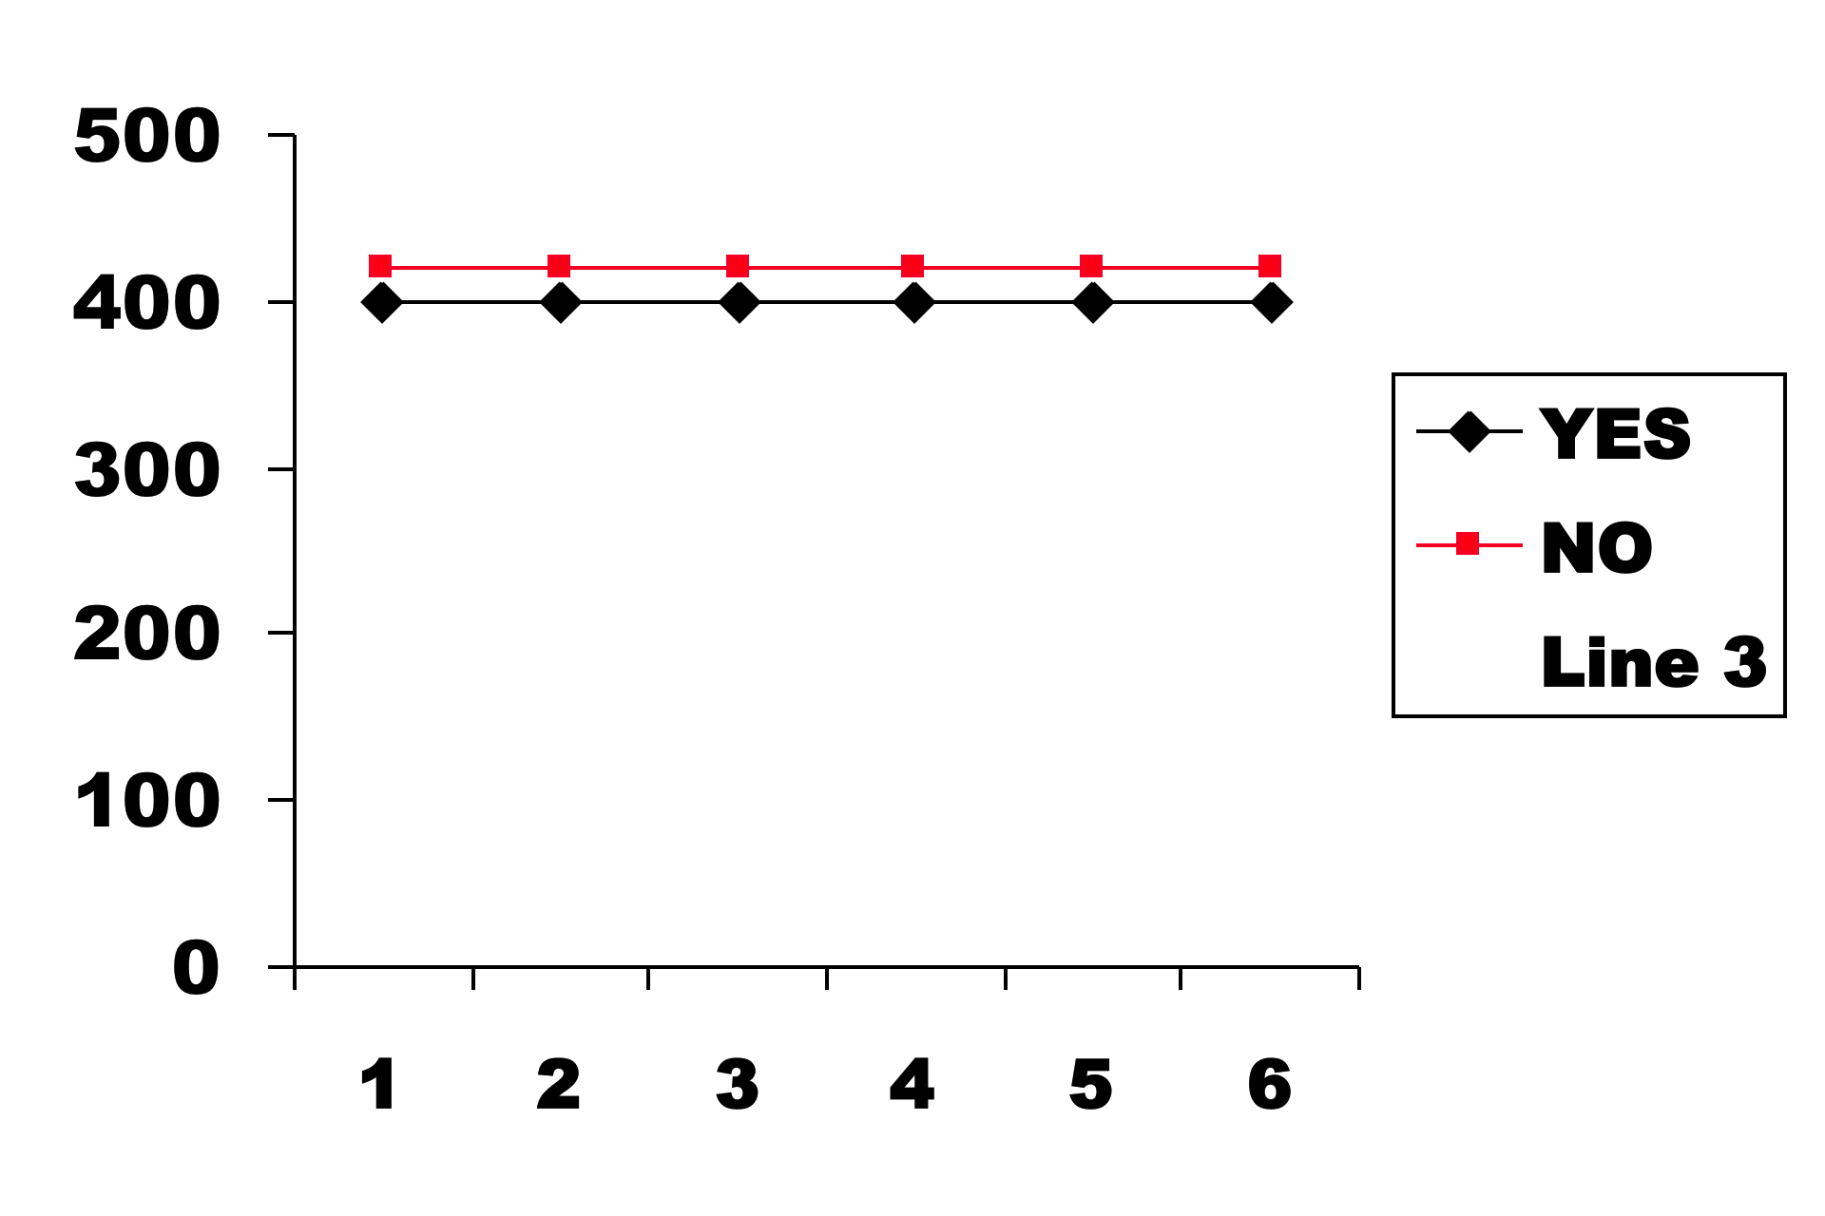
Memory search
If parallel search
  number of items does not matter
  Yes and No responses are both flat
Reaction time
Set size

Slide 38
Types of searches
(2) serial terminating: target item is compared to each item one after the other
  the answer (yes or no) is returned after the target is found or all items are searched
NO
5 3 2 9
8
8
8
8
8
8
8
8

Slide 39
Types of searches
(2) serial terminating: target item is compared to each item one after the other
  the answer (yes or no) is returned after the target is found or all items are searched
YES
5 3 2 9
Reaction time is faster for a yes response
3
3
3
3
3
3

Slide 40
If self-terminating search
Go through items one-by-one until find target
RT increases with set size
  YES RT’s shorter than NO RT’s
Lines have different slopes with 2:1 ratio
Reaction time
Set size

Slide 41
Types of searches
(3) serial exhaustive: target item is compared to each item one after the other
  the answer (yes or no) is returned after all items are searched (regardless of whether target is found or not)
NO
5 3 2 9
8
8
8
8
8
8
8
8

Slide 42
Types of searches
(3) serial exhaustive: target item is compared to each item one after the other
  the answer (yes or no) is returned after all items are searched (regardless of whether target is found or not)
YES
5 3 2 9
Reaction time is the same for a yes response as for a no response
3
3
3
3
3
3
3
3

Slide 43
If exhaustive search
Go through every item and then report answer
RT’s increases with set size
  YES RT increases the same as NO RT’s
Lines are parallel
Reaction time
Set size

Slide 44
Coding parallel search
I kept getting errors with ulam, so I am using the map/quap call in Rethinking
SSParallel <- map(
alist( RT ~ dnorm(mu, sigma),
mu <- a ,
a ~ dnorm(1000, 500),
sigma <- c1*Condition + c2*(1-Condition),
c1 ~ dunif(0, 2000),
c2 ~ dunif(0, 2000)
), data= SSdataTerminating )

Slide 45
Coding terminating serial search
I kept getting errors with ulam, so I am using the map/quap call in Rethinking
SSTerminating <- map(
alist( RT ~ dnorm(mu, sigma),
mu <- a + (b +(1-Condition)*b)*MemorySetSize,
a ~ dnorm(1000, 500),
b ~ dnorm(0, 100),
sigma <- c1*Condition + c2*(1-Condition),
c1 ~ dunif(0, 2000),
c2 ~ dunif(0, 2000)
), data= SSdataTerminating )

Slide 46
Coding exhaustive serial search
I kept getting errors with ulam, so I am using the map/quap call in Rethinking
SSExhaustive <- map(
alist( RT ~ dnorm(mu, sigma),
mu <- a + b*MemorySetSize,
a ~ dnorm(1000, 500),
b ~ dnorm(0, 100),
sigma ~ dunif(0, 2000)
), data= SSdataTerminating )

Slide 47
Model comparison
compare(SSTerminating, SSExhaustive, SSParallel)
WAIC SE dWAIC dSE pWAIC weight
SSExhaustive 97504.61 135.7654 0.0000 NA 3.437703 1.000000e+00
SSTerminating 97642.68 133.6923 138.0663 20.16741 4.603365 1.045401e-30
SSParallel 97837.28 130.5766 332.6726 38.40328 3.472748 5.768459e-73
Strongly favors the exhaustive model (same slope)
Might there be an even better model?

Slide 48
Conclusions
JZS Bayes Factors
Easy to calculate
Pretty easy to understand results
  Familiarity with ANOVA
A bit arbitrary for setting up
  Why not other priors?
  How to pick scale factor?
  Criteria for interpretation are arbitrary
A bit limited in model design compared to Rethinking package
Fairly painless introduction to Bayesian methods

