Slide 1
No effect of the moon size illusion on perceptual judgments: Bayesian analysis
Greg Francis
PSY 626: Bayesian Statistics for Psychological Science
Fall 2025
Purdue University

Slide 2

Moon illusion
When low on the horizon, the moon looks enormous

Slide 3
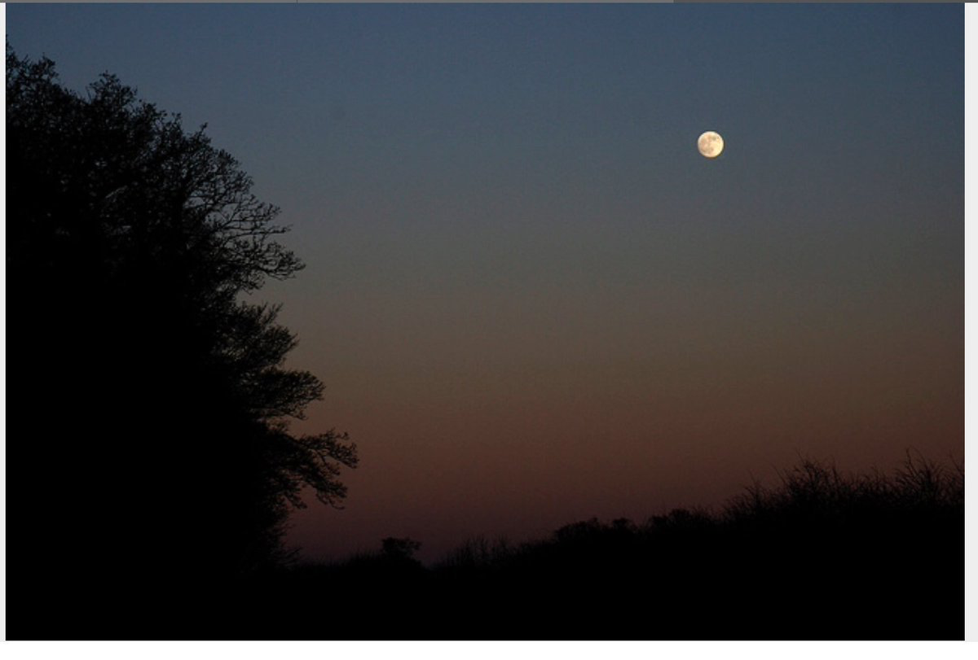
Moon illusion
When high in the sky, the moon looks smaller

Slide 4
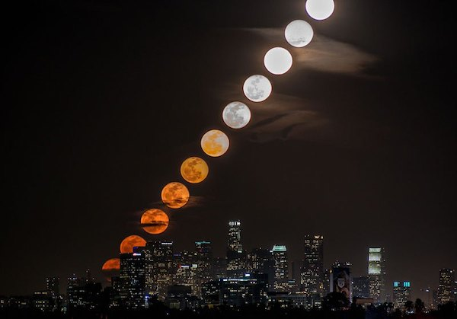
Moon illusion
In reality, the moon is always the same size and nearly always covers the same visual angle (0.5 degrees)

Slide 5
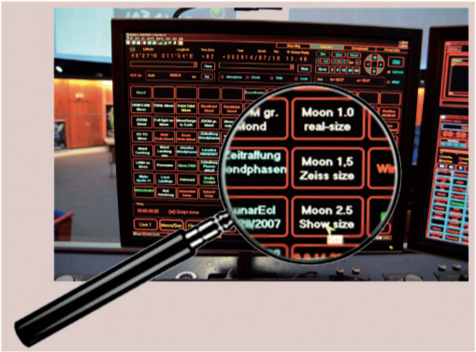
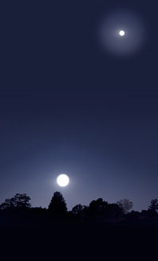
Don’t trust the internet
Lots of photos use tricks of photography to exaggerate the illusion
So called “super moons” hardly look bigger than a regular moon
Still, the illusion is quite vivid
A low moon appears 1.5-3 (or more)
times bigger than a high moon
Some planetariums have a setting to
artificially increase the projected
size of the moon
  Otherwise, guests complain that it
  looks too small (Carbon, 2015)

Slide 6
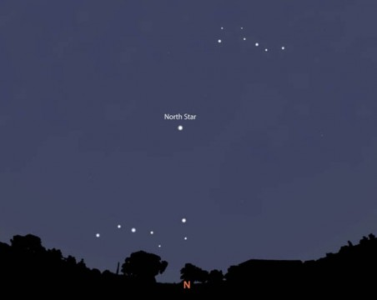
It’s not about the moon
There is a “sun” illusion (but don’t look at it!)
There is a “constellation” illusion

Slide 7
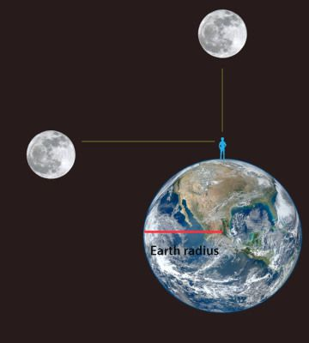
What’s the illusion?
Is it that the moon looks big when low on the horizon?
Is it that the moon looks small when high in the sky?
Surely, they are all size illusions because humans have no concept of the actual size or distance of the moon
Not to scale!
Really not to scale!

Slide 8
What’s the illusion?
The Earth has a radius of roughly 6350 kilometers
The moon has a radius of roughly 1738 kilometers
  The moon is a bit more than one-fourth the size of the Earth
I’ve got two circles here that have sizes the same proportion as the Earth and the moon
How far apart should I put them so that their separation is appropriately proportioned?
Our Earth circle has a radius of 3 inches.
The moon is approximately 394,000 km from Earth.
So, to be in proportion, the moon should be 62 Earth radii away.
Thus, the moon circle should be 15.5 feet away.
Notes:
Moon is approximately 394,000 km from the Earth. So separation should be 62 Earth radii. If Earth circle has a radius of 3 inches, the separation should be around 15.5 feet.

Slide 9
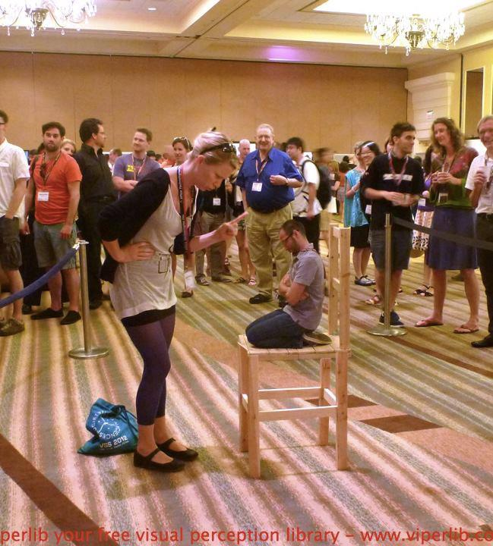
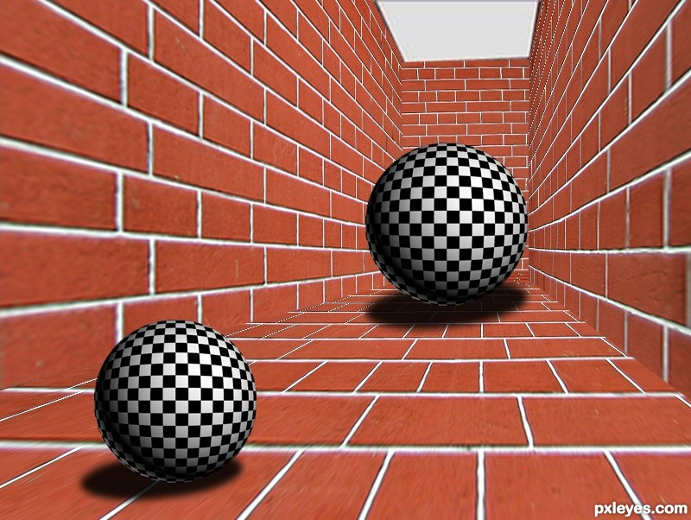
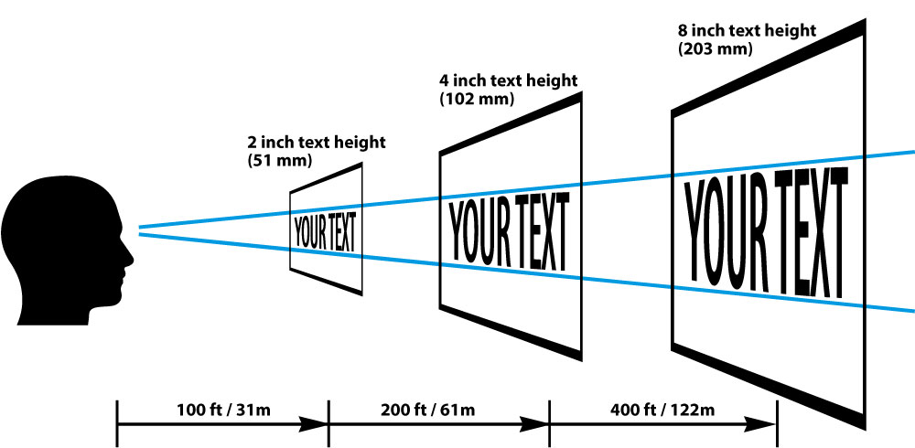
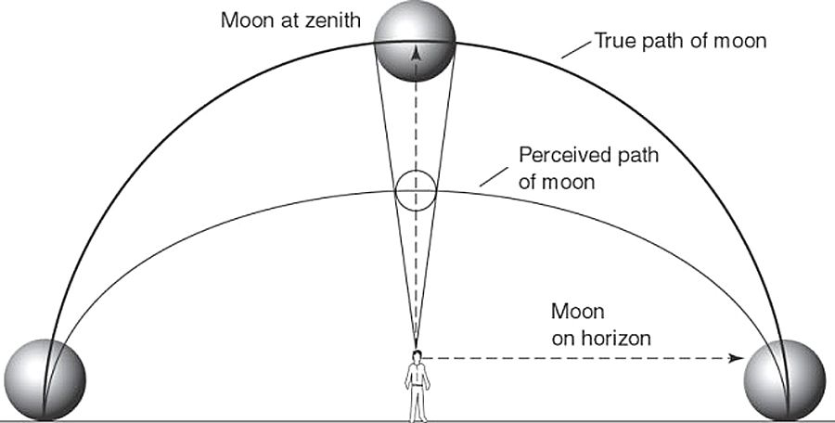
Perceived size
Perceived size is a combination of distance and visual angle

Slide 10
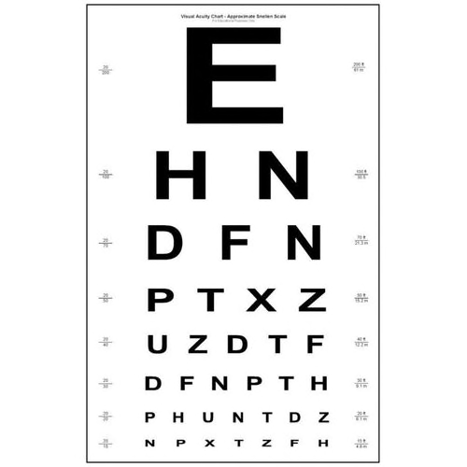
Perceptual judgments
Bigger stimuli result in better judgments
Eye charts

Slide 11
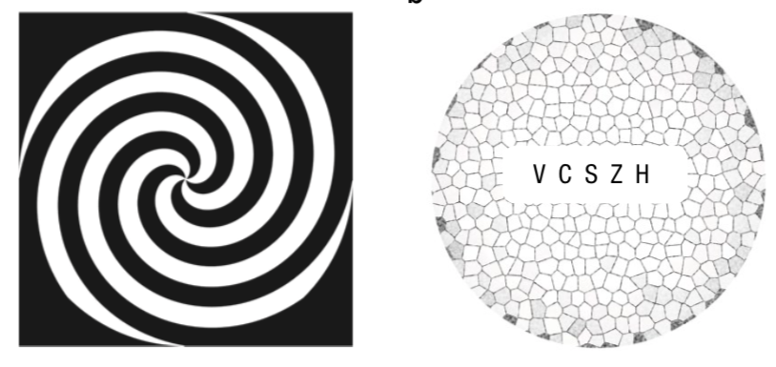
Perceptual judgments
What if the stimuli have the same visual angle, but one appears to be larger than the other
  Is that enough to improve perceptual judgments?
Lages, Boyle & Jenkins (2017)
  Motion aftereffect produces illusion of large or small letters

Slide 12
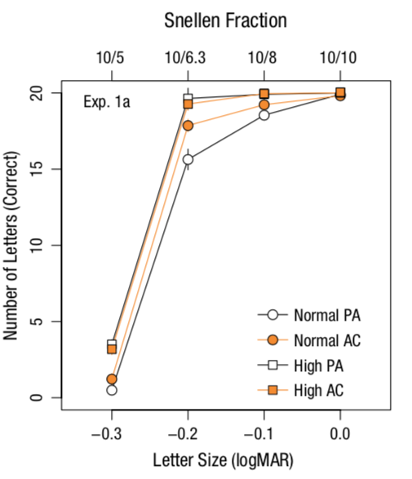
Perceptual judgments
More letters detected after adaptation to contracting motion (for observers with normal acuity)
  Orange circle above white circle
N=44

Slide 13
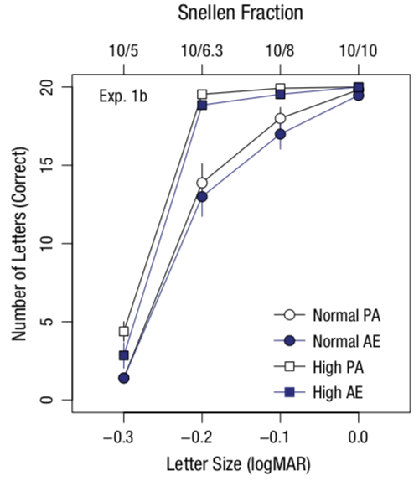
Perceptual judgments
Fewer letters detected after adaptation to expanding motion (for observers with normal acuity)
  Purple circle below white circle
N=30

Slide 14
Perceptual judgments
Bigger stimuli result in better judgments

Slide 15
Perceptual judgments
Bigger stimuli result in better judgments

Slide 16
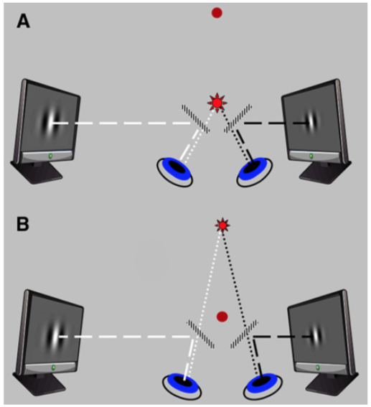
Perceptual judgments
Schindel & Arnold (2010)
Manipulate vergence
Keep retinal image constant
Far stimulus looks big
Near stimulus looks small
Retinal information is
the same

Slide 17
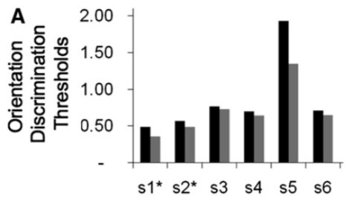

Perceptual judgments
Smaller thresholds (better judgments) for Far stimuli (look big) than for Near stimuli (look small)
N=6

Slide 18
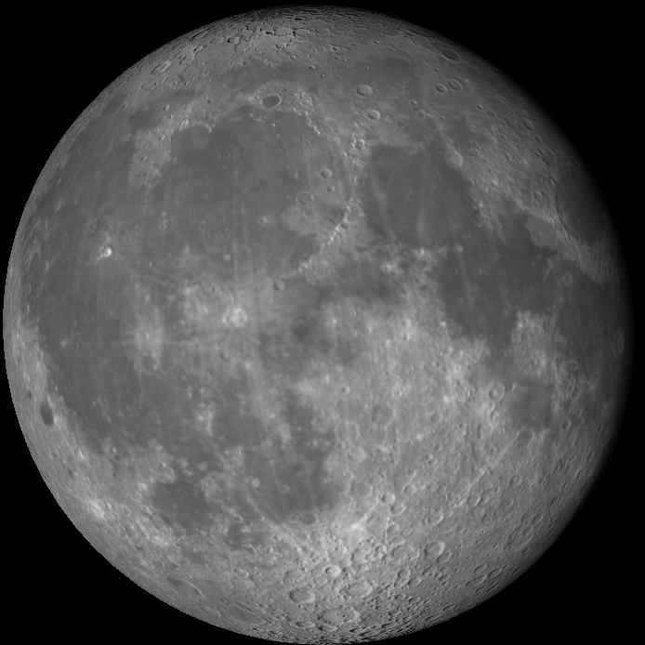
Moon illusion
When the moon is low, it feels like you can see all kinds of detail
When the moon is high, it feels like it would be difficult to make judgments about the moon

Slide 19
However
An illusion is always a distortion of reality
Perceptual accuracy is relative to reality, so how can a distortion help?
The best information available is always the retinal image
Of course, the visual system must distort that information somewhat (e.g., emphasize some frequencies over others, bias toward some orientations versus others)
  But you will always do best with the least distorted information
  Suggests that an illusion can only make you do worse!

Slide 20
Moreover
If an illusion actually does allow you to perform better at some perceptual task
Then your visual system must have had (or been able to have) that information even in the non-illusory setting
For some reason, your visual system elected to not access/include that available information
We decided to test the suggested relationship between perceived size and perceptual performance with the moon illusion

Slide 21
Basic idea
Observers judge the orientation of the moon by rotating an image on their phone so that it is in the same orientation as the moon in the sky

Slide 22
Basic idea
We can measure the error between the orientation of the image on the phone and the orientation of the moon in the sky
  If perceptual accuracy is influenced by the moon illusion, then errors should be bigger for higher (perceived smaller) moons
  We will test for a positive correlation between error and altitude

Slide 23
Power analysis
Schindel & Arnold (2010): within subjects design, but we can ignore the correlation between measures to estimate the effect size for a corresponding between subjects design
We convert to a correlation as

Slide 24
Power analysis
Lages et al. (2017): compared acuity for the expanding and contracting conditions
We convert to a correlation as

Slide 25
Size of the size illusion
Presumably, a bigger illusion makes for a bigger effect on perceptual judgment accuracy
Schindel & Arnold (2010) measured the size illusion to be a factor of 1.25
Lages et al. (2017) did not measure the size illusion induced by the motion after effect (should be small)
The moon illusion is often a factor 1.5 – 3 (or larger)
  There’s no simple way of measuring it
We anticipate the perceived differences in the size of the moon across different altitudes to be much larger than for the stimuli used by Schindel & Arnold or Lages et al.

Slide 26
Power
Thus, a plausible standardized effect size for the moon illusion is
For big enough sample sizes, this corresponds to
To get 0.9 power, we need n=121 observers
We ran 320 subjects, but 90 of them could not complete the experiment because of clouds
Thus, we ended up with n=230 subjects
  If the effect is r=0.29, then we have power=0.99
  If the effect is r=0.18, as in Schindel & Arnold (2010), then we have power=0.79
  If the effect is r=0.38 as in Lages et al. (2017), then we have power=0.9999

Slide 27
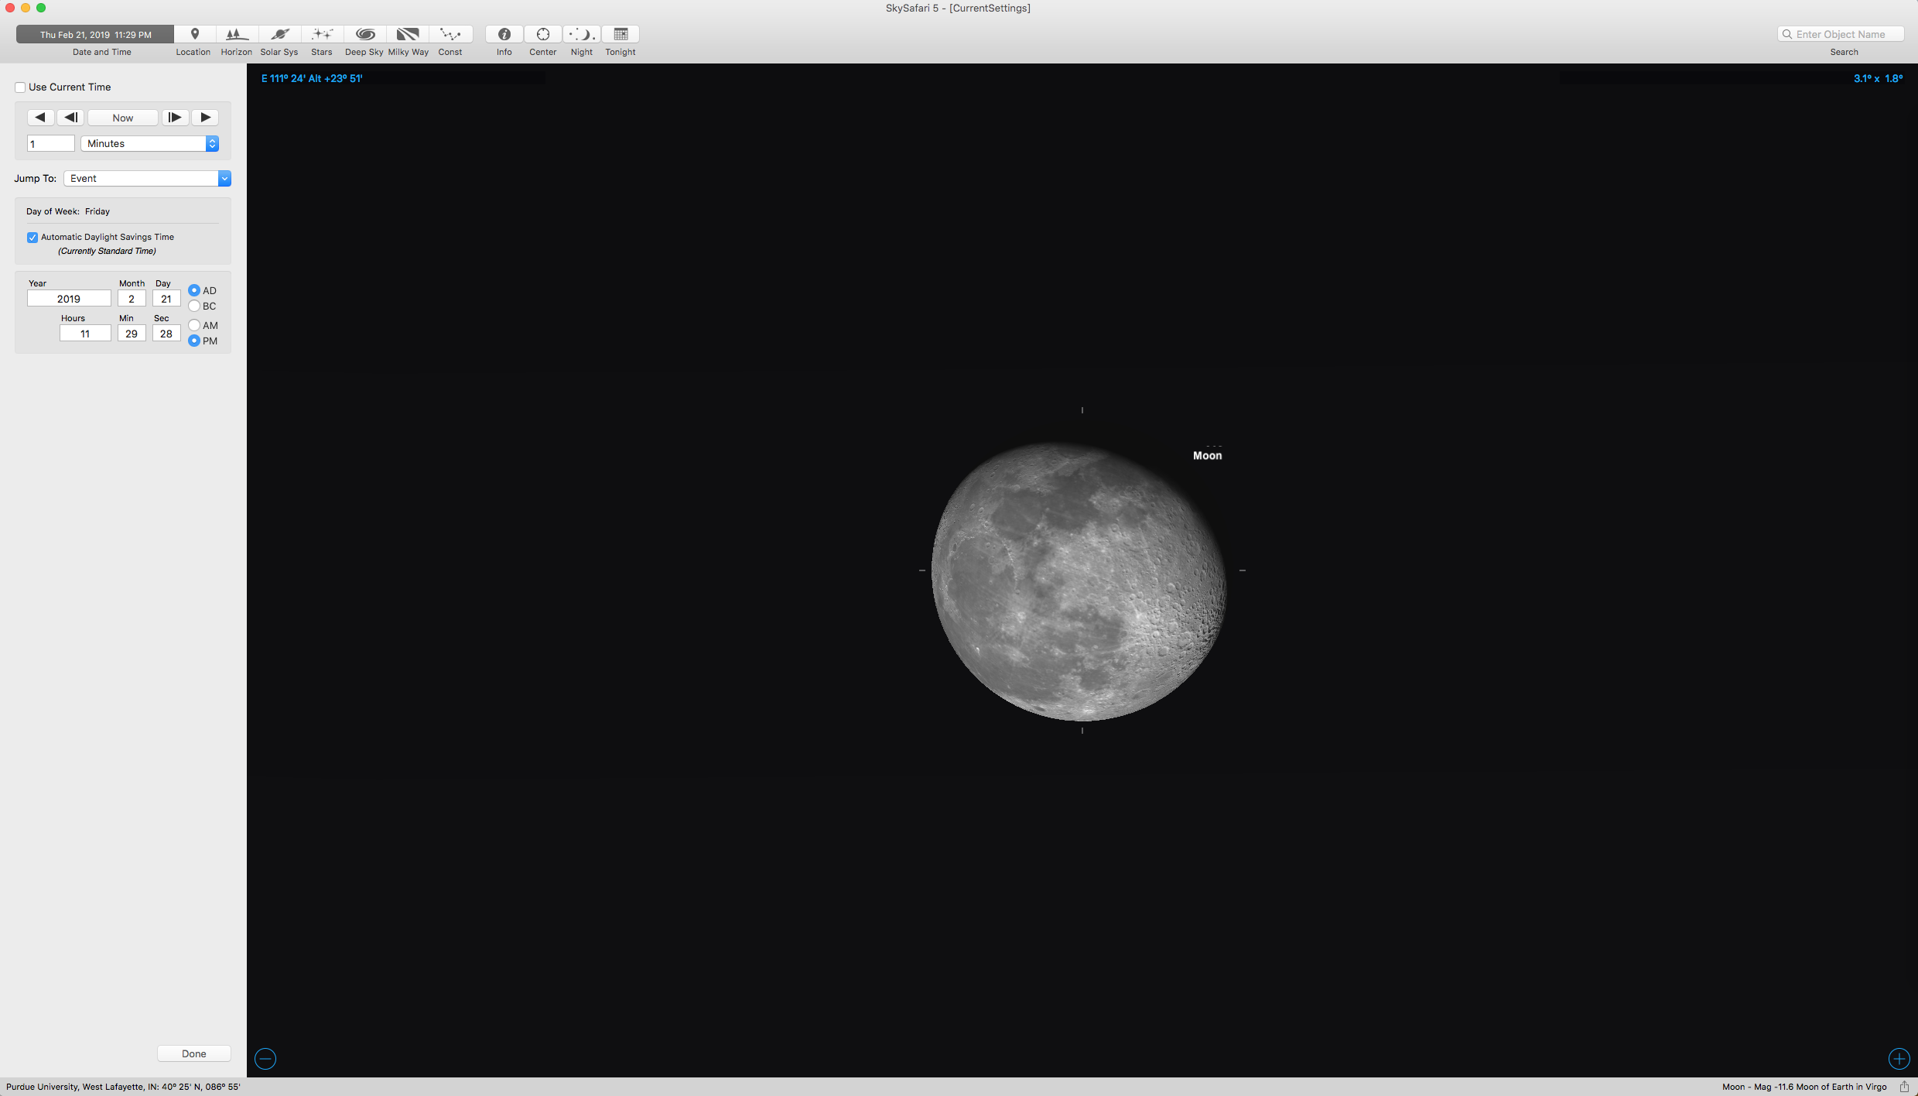
Stimuli
Moon in the sky:
  Within 3 days of a half moon
  Altitudes between 0 and 35 degrees (Carbon, 2017)
  Rising and setting moons
  Waxing and waning moons
  Daytime and nighttime moons
Moon on the phone:
  Image matches moon in sky to within 3 hours
  Generated by a program called Sky Safari
    Created in advance, images of the moon for every 6 hours between 07:55:06 August 26, 2018 through 18:55:06 December 24, 2018
    Phone app selected the image closest in time to the start of the experiment
    Cropped
    Rescaled by the phone app

Slide 28
Moon on phone
The moon phase changes continuously, but it is very slow
Hardly noticeable during a span of 3 hours
Lots of relative rotation, though!

Slide 29
Task
Observer judges the orientation of the moon by rotating an image on their phone so that it is in the same orientation as the moon in the sky
String established true vertical orientation
2 practice trials, 10 experimental trials, 3 demographic questions
Timestamp for each judgment (to the nearest second)

Slide 30
Measuring true orientation
We have a timestamp of each judgment made by each observer
  2300 judgments, but 102 duplicates (so 2198 unique timestamps)
We want to know the true orientation of the moon in the sky at each time
We created a program that drove Sky Safari to display the moon at each timestamp and save the image
We created another program where we manually identified one of two key moon features
This allows us to identify the orientation of the moon relative to a vertical line dropped straight down to the horizon

Slide 31
True orientation: waxing moon
Small bump in the Mare Crisium crater

Slide 32
True orientation: waning moon
Center of the Aristarchus crater

Slide 33
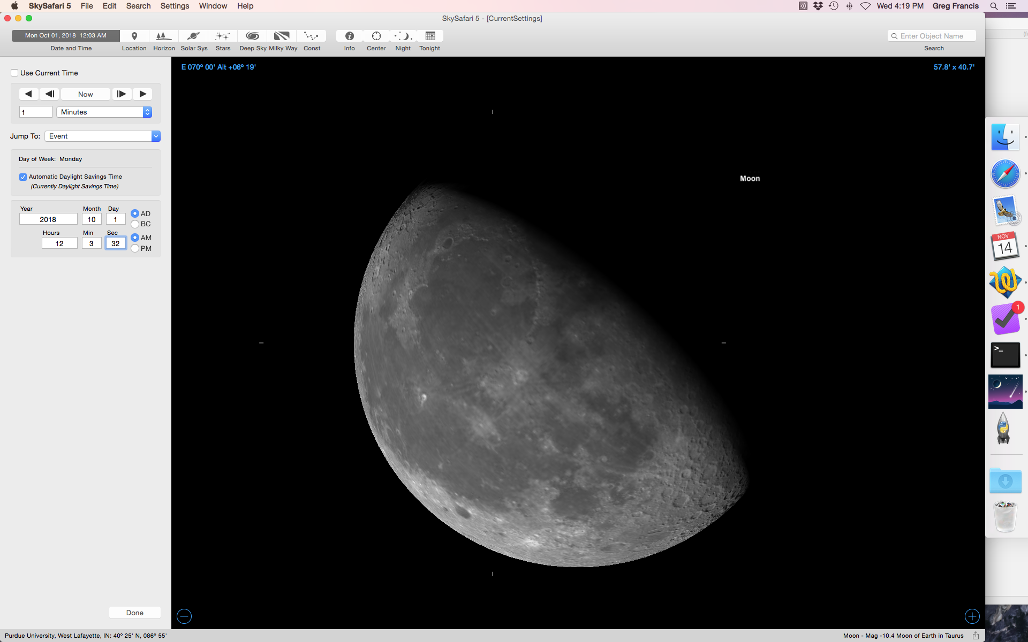
Altitude
Sky Safari also provides the altitude of the moon (to the nearest arc minute)
We wrote another program to read in the altitude information
So, for each
of the 2198
judgments
we have the
true moon
orientation
and altitude

Slide 34
Judged orientation
The observer rotates the moon image on the phone so that it is oriented relative to the sides of the phone in a way to match the orientation of the moon in the sky relative to the vertical string
We first need to know the relative orientation of the phone moon image without any observer-produced rotation
We do this with the same kind of program designed to identify the true orientation of the moon in the sky

Slide 35
Judged orientation
With the relative orientation of the image and the amount of rotation provided by the observer, we get the relative image orientation that is perceived to match the orientation of the moon in the sky

Slide 36
Judged orientation
Thus, for each judgment, we compute
We want to see how this value compares to the true orientation of the moon
Positive error means that the judged orientation was clockwise of the true orientation
Negative error means that the judged orientation was counterclockwise of the true orientation

Slide 37
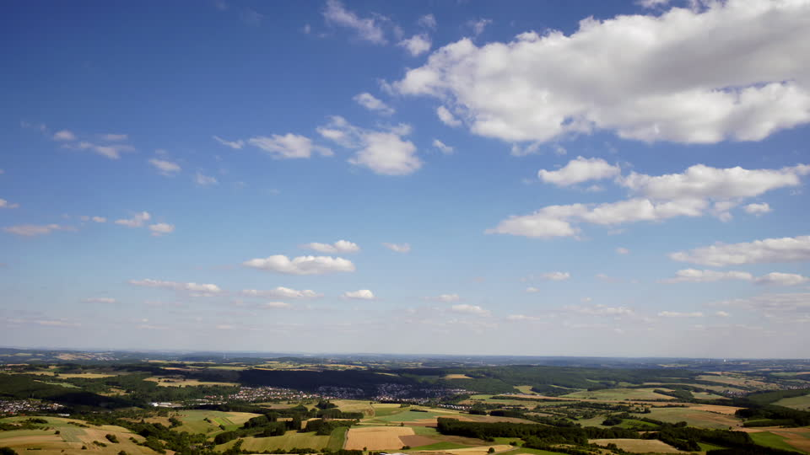
Results: Altitudes
More high altitude measures than low-altitude measures
Because clouds reduce visibility of low altitude moons
We required that the moon was clearly visible before making any judgments

Slide 38
Results: Errors
Across all judgments, most errors are between -25 to +25 degrees
A few subjects have consistently large errors (around 180 degrees)
  We think they
  misunderstood the task
  and tried to “complete”
  the moon rather than
  “match” it
Other subjects might
have had a data entry
problem

Slide 39
Results: Errors
We treated all 125 responses outside of -45 to +45 degrees as mistakes
This removed all data from 11 observers
The final data set is 2175 responses for 219 observers

Slide 40
Averages for each subject
A subject may sometimes have error clockwise and sometimes counterclockwise
We averaged the errors across trials to get the best estimate for a subject
We did the same thing for the altitude of the moon
  The altitude changes continuously, but only a small amount for any given experiment.
    Mean=0.24 degrees, Max=1.3 degrees
So, each subject provides a mean error and a mean altitude
We want to see if these are related

Slide 41
Results
Use ulam() to compare three models
Null: no relation between error and moon altitude
Linear: some (positive or negative) relation between error and moon altitude
Positive Linear: a positive relation between error and moon altitude
If perceptual accuracy is determined by perceived size, the Positive Linear model should best match the data

Slide 42
Null
MINull <- ulam(
alist( AbsError ~ dnorm(mu, sigma),
mu <- a0,
a0 ~ dnorm(10, 10),
sigma ~ dunif(0, 100)
), data= MIdata, log_lik=TRUE, iter=10000, warmup=4000, chains=4, cores=4 )
> precis(MINull)
mean sd 5.5% 94.5% rhat ess_bulk
a0 4.58 0.26 4.15 5.0 1 16559.72
sigma 3.89 0.19 3.61 4.2 1 16024.99

Slide 43
Linear
MILinear <- ulam(
alist( AbsError ~ dnorm(mu, sigma),
mu <- a0 + a1*Altitude,
a0 ~ dnorm(10, 10),
a1 ~ dnorm(0, 20),
sigma ~ dunif(0, 100)
), data= MIdata, log_lik=TRUE, iter=10000, warmup=4000, chains=4, cores=4 )
> precis(MILinear)
mean sd 5.5% 94.5% rhat ess_bulk
a0 6.23 0.83 4.91 7.54 1 7813.51
a1 -0.07 0.03 -0.13 -0.02 1 7952.18
sigma 3.87 0.19 3.58 4.18 1 10929.40

Slide 44
Positive Linear
MIPositiveSlope <- ulam(
alist( AbsError ~ dnorm(mu, sigma),
mu <- a0 + a1*Altitude,
a0 ~ dnorm(10, 10),
a1 ~ dnorm(0, 20),
sigma ~ dunif(0, 100)
), data= MIdata, constraints=list(a1="lower=0,upper=100"), log_lik=TRUE, iter=10000, warmup=4000, chains=4, cores=4 )
> precis(MIPositiveSlope)
mean sd 5.5% 94.5% rhat ess_bulk
a0 4.28 0.38 3.64 4.82 1 8003.66
a1 0.01 0.01 0.00 0.04 1 6477.48
sigma 3.91 0.19 3.62 4.23 1 11467.00

Slide 45
Model comparison
> compare(MILinear, MIPositiveSlope, MINull)
WAIC SE dWAIC dSE pWAIC weight
MILinear 1216.9 31.69 0.0 NA 4.5 0.67
MINull 1219.0 32.86 2.1 4.82 3.3 0.24
MIPositiveSlope 1220.9 32.98 4.0 5.62 3.5 0.09
Only viable choices are the Linear or null models

Slide 46
Posterior
From the linear model we can compute the probability that the slope is positive
samples <- extract.samples(MILinear)
cat("Probability slope is positive = ", length(samples$a1[samples$a1 >0])/length(samples$a1) )
Probability slope is positive = 0.017875

Slide 47
Results: t-test
Unsigned (absolute value) error
Previous research suggested that errors should be smaller for lower (perceived bigger) moons
We find the opposite relationship
  r= -0.139
  t= -2.073
  p= 0.039
N=219

Slide 48
Results: BayesFactor
In R, the BayesFactor package provides a “default” test for correlation
> correlationBF(MIdata$AbsError, MIdata$Altitude)
Bayes factor analysis
--------------
[1] Alt., r=0.333 : 1.247672 ±0%
Against denominator:
Null, rho = 0
---
Bayes factor type: BFcorrelation, Jeffreys-beta*
This is not a correlation.
It is a “medium” scale factor for the prior. This is the default.

Slide 49
Results: BayesFactor
In R, the BayesFactor package provides a “default” test for correlation
We can get posterior information
samples = correlationBF( MIdata$Altitude , MIdata$AbsError, posterior = TRUE, iterations = 10000)
> mean(samples[,"rho"])
[1] -0.1358836
> plot(samples[,"rho"])

Slide 50
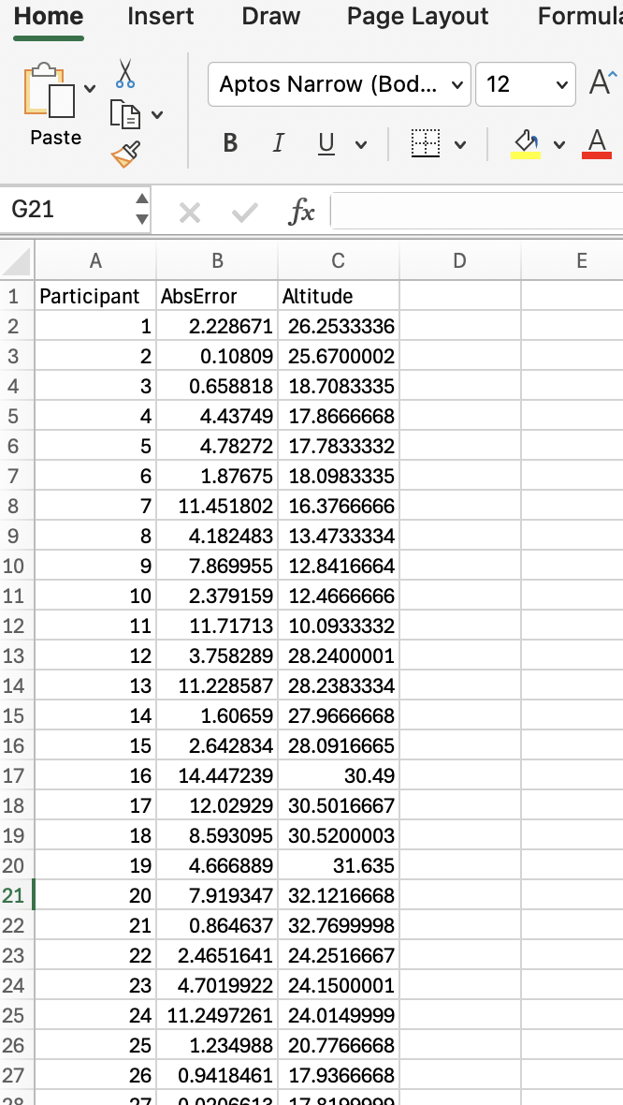
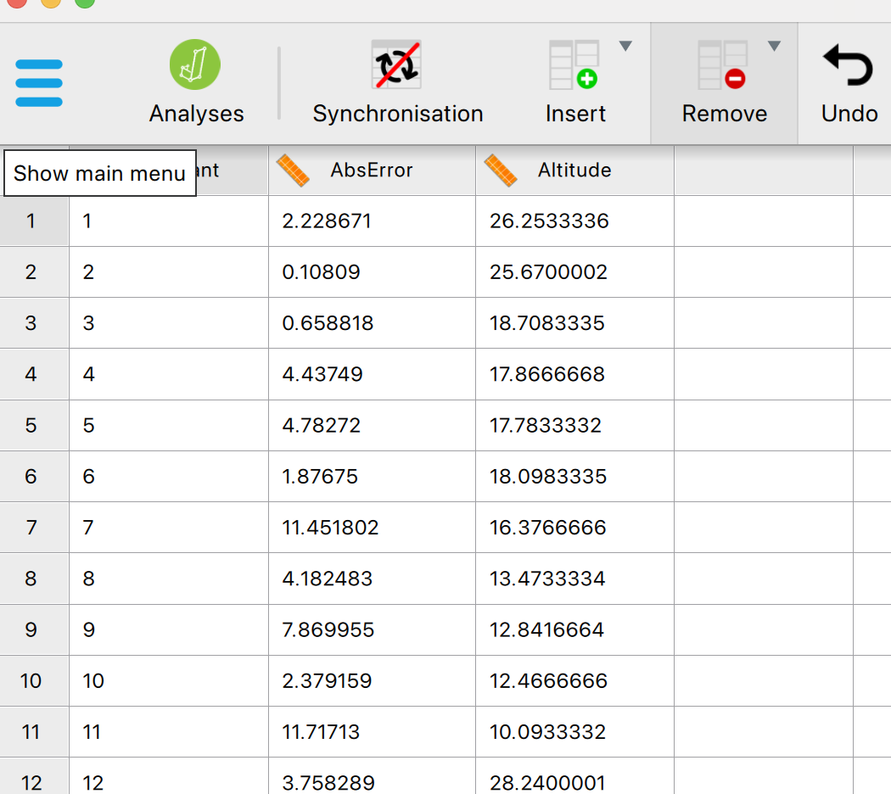
Results: JASP
Organize data in a format that works for JASP
Copy and paste into JASP

Slide 51
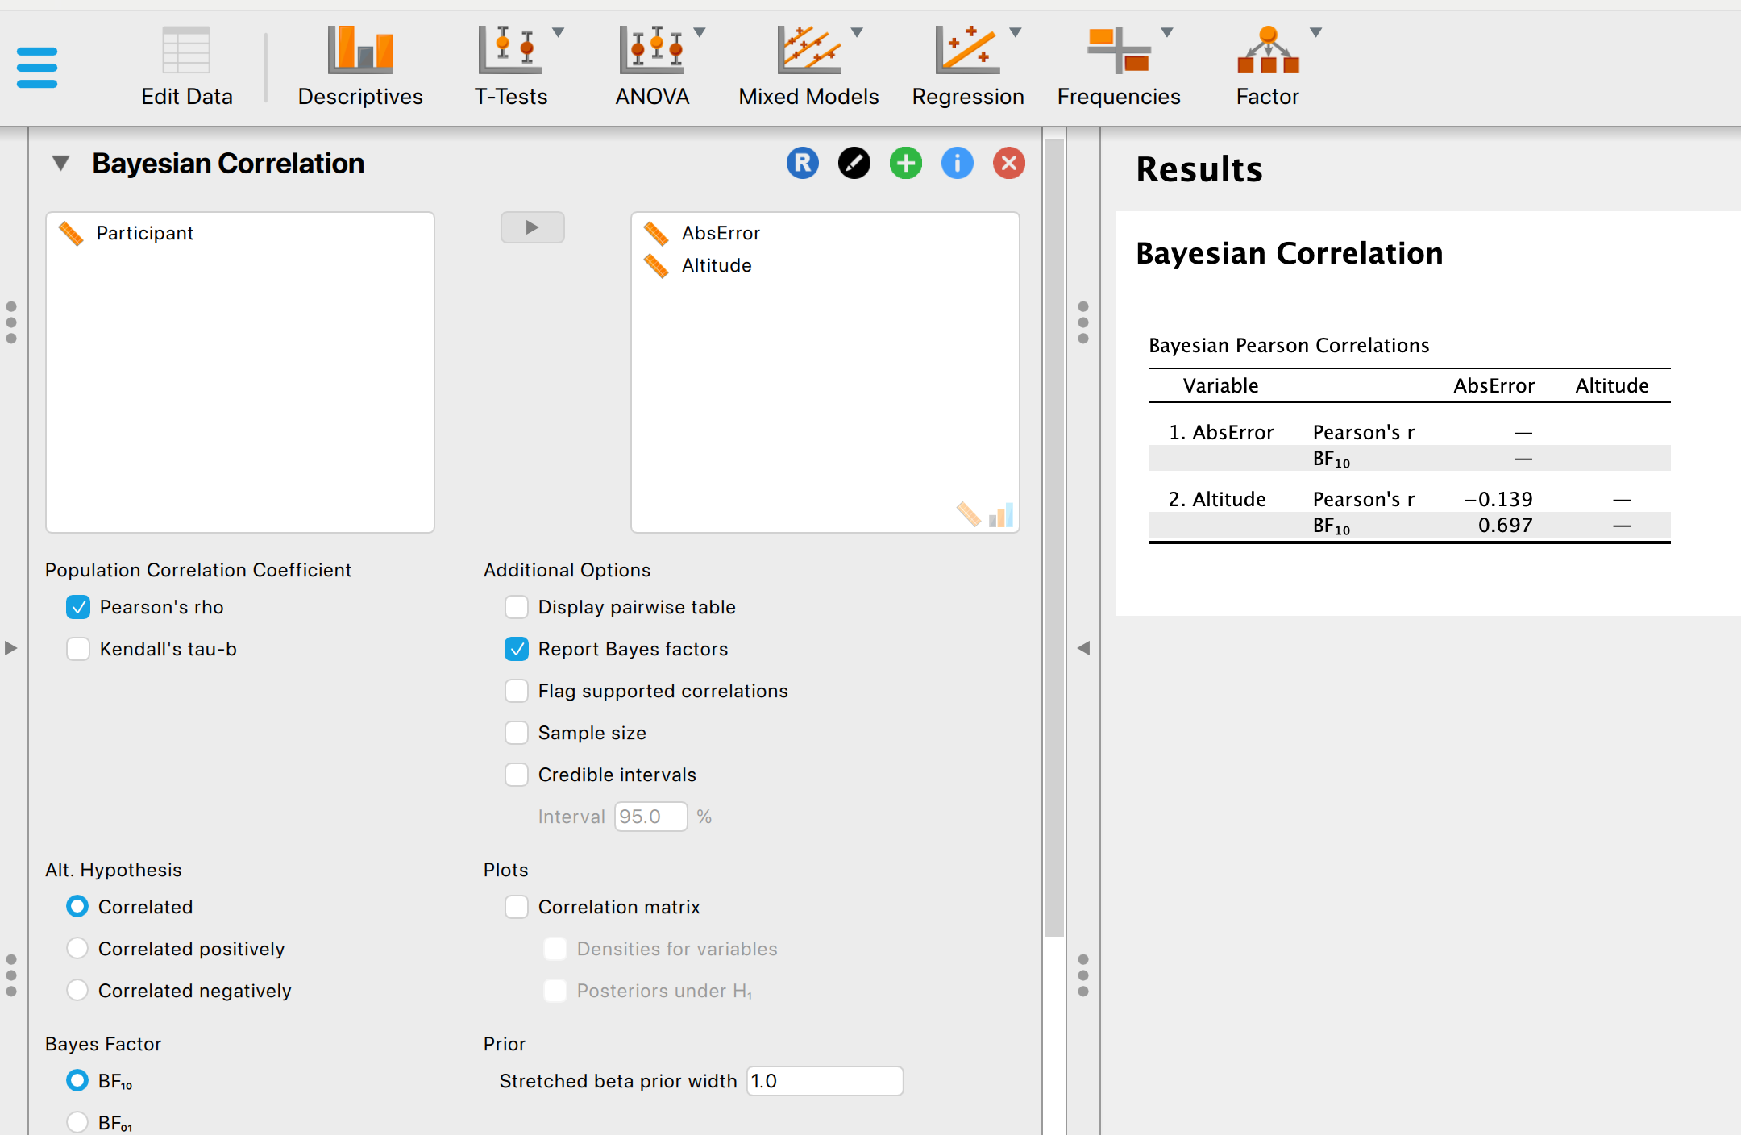
Results: JASP
Drag over variables to the right column and the analysis is done automatically
The default is an “ultrawide” scale factor

Slide 52
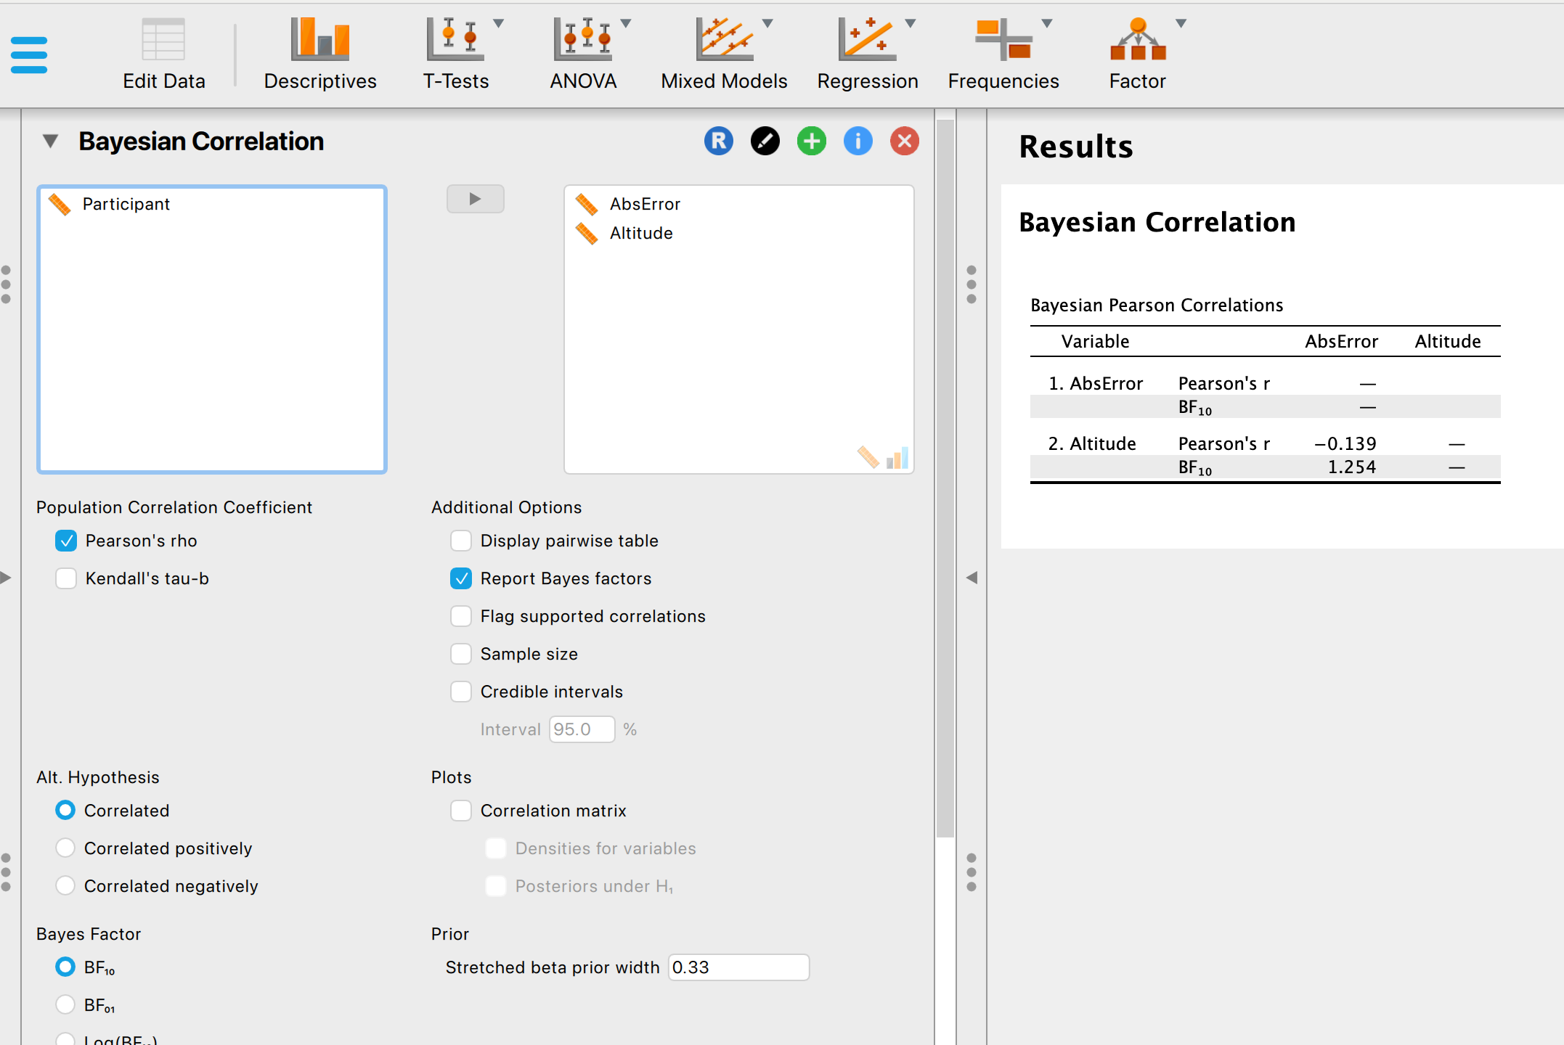
Results: JASP
We can set the scale factor to a ”medium” value
Now the BF matches that produced by the BayesFactor package

Slide 53
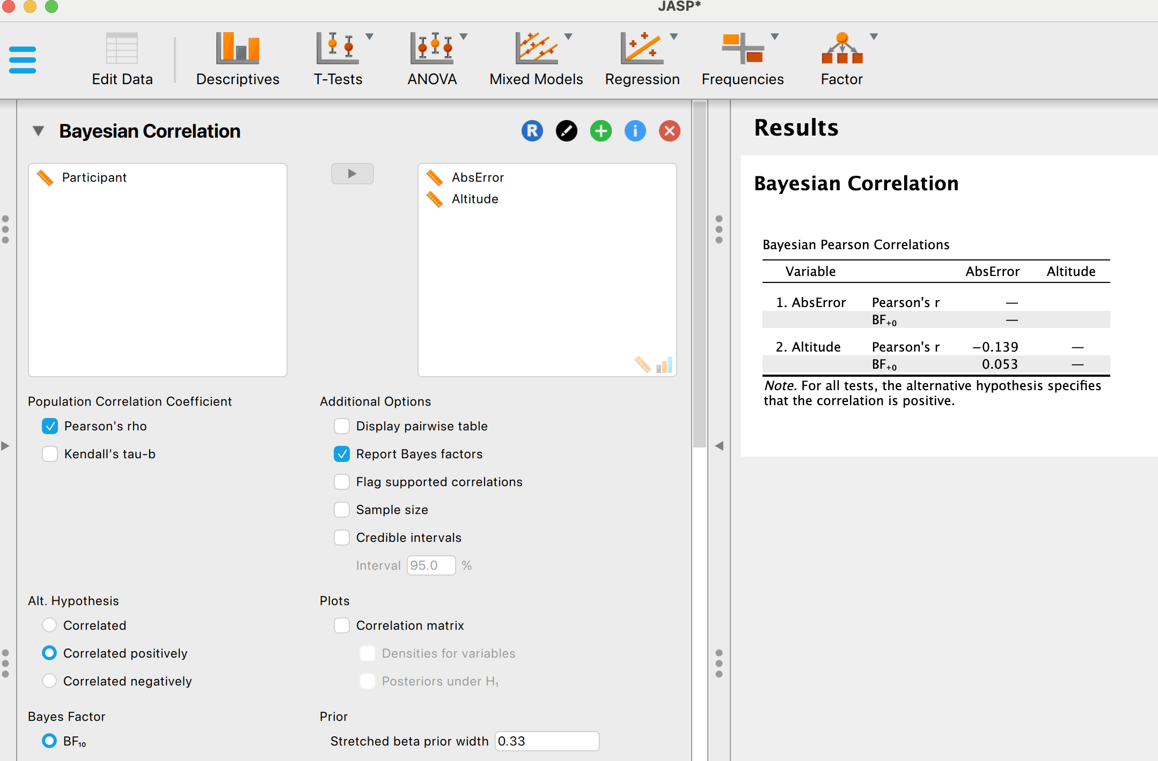
Results: JASP
We can do a one-sided test (we hypothesized a positive slope)
Now the BF favors the null (rho=0)

Slide 54
Why a negative relationship?
Two possibilities:
More atmosphere for a moon at the horizon makes the image a bit fuzzy
  Should be weak because we insisted on a clearly visible moon
The moon is a bit further away when on the horizon compoared to high in the sky (by one earth radius)
  Should be weak because the difference in visual angle is only from 0.5053 (horizon) to 0.5136 (high in the sky)

Slide 55
Perception and perceived size
If perceptual accuracy improves with increases in illusory size for the moon illusion, it must be a very small effect
So small, that other (also small) effects that run in the opposite direction remain detectable

Slide 56
Previous work
We find a rather different result than Schindel & Arnold (2010) and Lages et al. (2017)
Perhaps the effect varies across different types of illusions
Perhaps those studies should be replicated with larger sample sizes
Actually, there is something odd about the analysis in Schindel & Arnold (2010)

Slide 57
Re-analysis
From the raw data, we can repeat the dependent t-test for a difference of means
  Non-significant result!
N=6

Slide 58
Re-analysis?
Instead of computing a difference score for each subject and testing if the mean difference score is different from 0
Schindel & Arnold (2010) computed a ratio score for each subject and tested if the mean ratio is different from 1
  This is a horrible test (Type I error varies with sample size and size of population means)
  Power is very low
N=6

Slide 59
Conclusions
Using a stimulus that should produce a very large illusion
In an experiment that should be well powered to find effects similar to what was previously reported
We find no evidence that perceptual judgments are influenced by the perceived size of a stimulus
Bayesian analysis did not differ in any meaningful way from the t-test

