Slide 1

Excess success in investigations of object-based attention
Greg Francis
Evelina Thunell
10 November 2020

Slide 2
Visual attention
People can process information where they are not directly looking
E.g., Posner (1980), cuing a spatial location improves processing
  Shorter reaction time to a target
L

Slide 3
Visual attention
People can process information where they are not directly looking
E.g., Posner (1980), cuing a spatial location improves processing
  Longer reaction time to a target
T

Slide 4
Attentional spotlight
Visual attention is tied to spatial locations
Visual attention can be moved around to increase processing efficiency where it is applied
L

Slide 5
Attentional spotlight
Many variations
  Exogenous cue (vs. endogenous cue)
  Vary timing between cue and target
  Detection, identification, discrimination tasks
  Measure reaction time, correct detection, d-prime
  Specialized subjects (patients)
  Distance from attentional focus (gradient of attention)
L

Slide 6
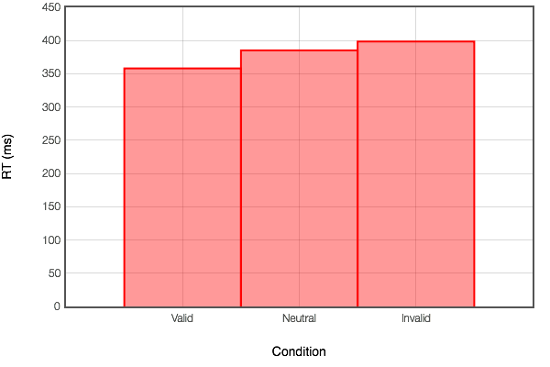
Typical data
Simple detection task (arrow cue)
  College students (37,759)
  Within-subjects design
  40 ms difference in reaction time between valid and invalid trials

Slide 7
Two-rectangles method
Egly, Driver & Rafal (1994)
  Valid cue

Slide 8
Two-rectangles method
Egly, Driver & Rafal (1994)
  Invalid cue, same object

Slide 9
Two-rectangles method
Egly, Driver & Rafal (1994)
  Invalid cue, different object

Slide 10
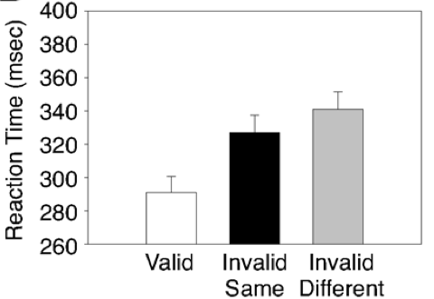
Typical data
Marrara & Moore (2003)
Fastest RT for valid trial (spatial cuing)
RT difference of around 17 ms for same-object vs. different-object trials
Invalid same
Invalid different

Slide 11
Object-based attention
Egly, Driver & Rafal (1994)
  Invalid cues
Same object: Faster
Different object: Slower

Slide 12
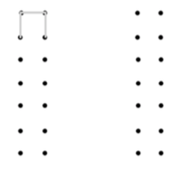
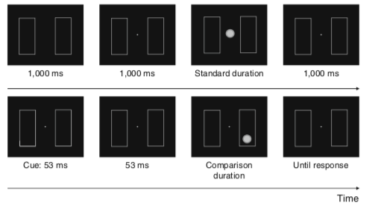
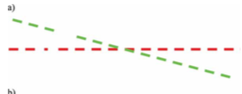
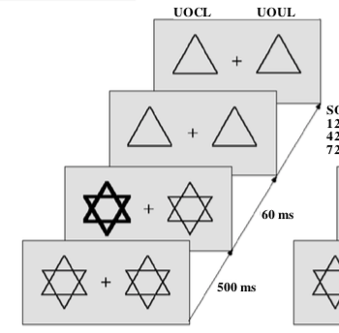
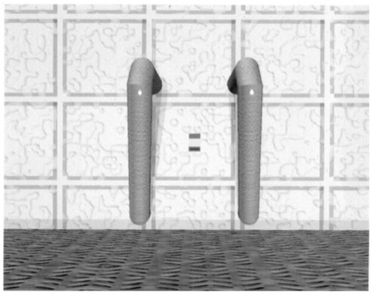
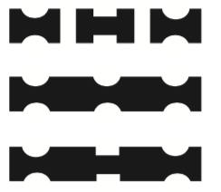
Object-based attention
Egly, Driver & Rafal (1994)
Incredibly influential work
1226 citations in Google Scholar as of October 2018
100s of experimental variations of
  Stimuli
  Cues
  Timing
  Patients
  Tasks
  Priming
  Interactions of all of these

Slide 13
Neural modeling
Lots of empirical studies of an important topic is like a gold mine for a modeler
I am pretty sure that my neural
network model of visual perception
(Francis et al., 2017) can produce
some object-based attention effects
Segmentation/selection can
“remove” a rectangle that would
otherwise impair detection of
a target (uncrowding)

Slide 14
Cartoon explanation
Cortical cells in the model respond to “edges” of the stimulus
Cortical cells
Stimulus

Slide 15
Cartoon explanation
The onset of a cue guides a selection signal at the cue location
Cortical cells
Stimulus: Cue

Slide 16
Cartoon explanation
Crowding for different-object trials
Cortical cells
Stimulus: Invalid Different object

Slide 17
Cartoon explanation
Release from crowding for same-object trial
Cortical cells
Stimulus: Invalid Same object

Slide 18
Neural modeling
I was all set to start modeling object-based attention effects
  Grant was submitted to NSF
  Early simulations looked promising
As I started to identify the studies I would use for simulations, I was bothered by some of the findings
  The effects are small (10-15 ms are common)
  The sample sizes are small (10-20 observers is common)

Slide 19
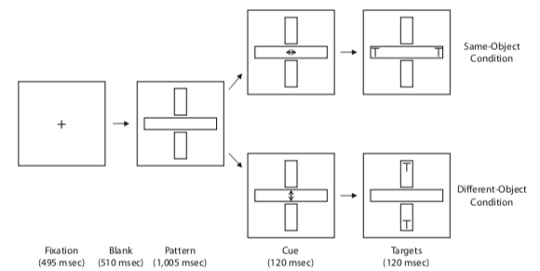
Representative finding
Chen & Cave (2008)
  “Object-based attention with endogenous cuing and positional uncertainty”
Experiment 1: Within subjects design
  RT was shorter when letters appeared on the same object than on two different objects
  Same: M=625 ms, SE=26.6
  Different: M=639 ms, SE=26.9
  t(13)=3.99, n=14
  Standardized effect
  size of d=0.14
    For a between
    subjects design

Slide 20
Puzzling numbers
Variance sum law:
From the given t-value, and the means, we can compute the left side
With the standard errors, we can compute the sample standard deviation for each condition
So, you can solve for the correlation

Slide 21
Puzzling numbers
This seems like a really high correlation for reaction times
For comparison, I checked the correlation between valid and invalid trials in a Posner spatial cuing task
  Each subject provides a mean RT for each condition
Task | Comparison | Correlation | n
Posner spatial cuing | Valid vs. invalid | 0.63 | 224
Stroop | Congruent vs. Incongruent | 0.9 | 227
Simon effect | Congruent vs. Incongruent | 0.96 | 183

Slide 22
Puzzling numbers
Small mean differences (5-20 ms) are coupled with small sample sizes
Chen & Cave (2008)
  Experiment 1: n=14
  Experiment 2: n=19
  Experiment 3: n=14
  Experiment 4: n=14
  Experiment 5: n=14
Dodd & Pratt (2005)
  Experiment 1: n=8
  Experiment 2: n=8
  Experiment 3: n=15
  Experiment 4: n=15
For perspective, in a study of stimulus-response compatibility, Yamaguchi, Chen, Mishler & Proctor (2018) reported mean differences of 20-40 ms and had sample sizes of
Experiment 1: n=41
Experiment 2: n=40
Experiment 3: n=40
Experiment 4: n=41

Slide 23
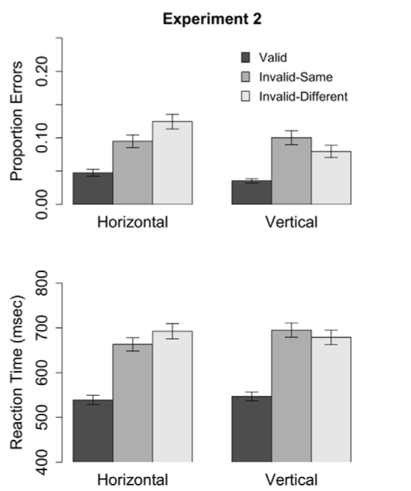
Big study
Worse, Pilz et al. (2012) found that the object-based attention effect depends on the orientation of the rectangles
  A reverse effect for vertical rectangles
n=120

Slide 24
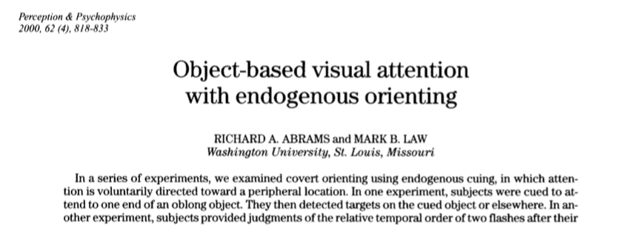
Excess success
While reading various papers on object-based attention, I noticed that some seemed too good to be true
  Lots of p-values just below the 0.05 criterion
Formal analysis with the Test for Excess Success
Let‘s go through an easy case
  Eight experiments

Slide 25
Experiment 1
Direct replication of the Egly et al. (1994) two-rectangles method
n=15
Key result is a significant difference for invalid cue same-object and invalid cue different-object conditions, t(14)=2.7, p<.05
Effect size:

Slide 26
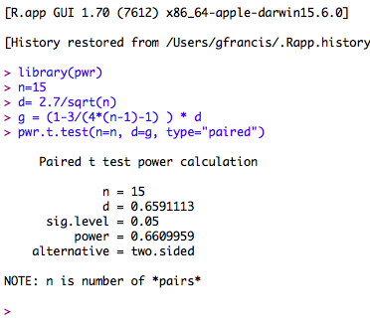
Experiment 1
Suppose the experiment accurately measured the population effect
What is the probability (power) that another experiment with the same sample size would produce a significant t-test?
Power = 0.661

Slide 27
Experiment 2
Endogenous cue (central arrows)
Vary interstimulus interval (ISI) between cue and target
Results
  Interaction of cue-target interval and cuing condition, F(2,28)=3.5, p<.05
  Object effect for ISI=300 ms, t(14)=3.3, p<.01
  No object effect for ISI=900 ms, t(14)=0.25
To estimate success, ideally we would consider all three tests, but we do not have enough statistical information to do that estimate
Instead, we use the weakest test and its success rate corresponds to a lowest upper bound on the success rate of the set of tests
Power for the tests is: 0.605, 0.826, and 0.944
The weakest test has power of 0.605.

Slide 28
Experiment 4
Varied stimuli, task, and type of cue (exogenous or endogenous)
Results included lots of tests, but the weakest is a null finding
  No significant interaction between type of cue and target location, F(1,9)=3.1, p=.11
A future replication study would support the findings here if it did not produce a significant interaction
Success rate = 1- power
0.698 = 1- 0.302

Slide 29
All experiments
We can do the same kind of thing for all experiments
The probability of 8 tests like these all producing successful outcomes is the product, P_{TES} = 0.063
 | N | Weakest statistic | Success probability
Experiment 1 | 15 | t=2.7 | 0.661
Experiment 2 | 15 | t=3.3 | 0.605
Experiment 3a | 16 | t=3.8 | 0.920
Experiment 3b | 16 | t=2.5 | 0.602
Experiment 4 | 10 | F=3.1 | 0.698
Experiment 5 | 15 | t=2.2 | 0.491
Experiment 6 | 16 | t=5.67 | 0.999
Experiment 7 | 15 | t=3.29 | 0.824

Slide 30
Excess success
So, if the effects reported in Abrams & Law (2000) are real and similar to what are reported in the paper
And if the experiments are run properly (e.g., random sample, full reporting)
Then, experiments like these should produce results consistent with the conclusions of the original paper only 6.3% of the time.
That seems like rather low odds (e.g. less than 10%), and it makes me think that the experiments were not done properly or fully reported
  Hard to know precisely what happened
  I’m reluctant to model experimental results that are unlikely to replicate even if true
  Reported effects probably overestimate reality

Slide 31
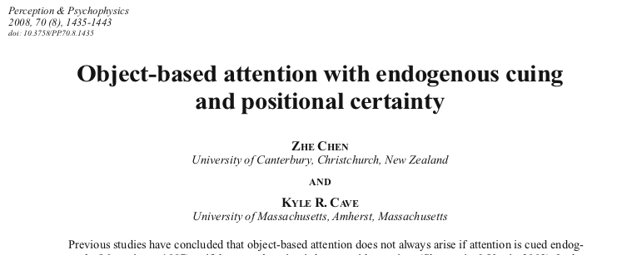
Complicated case
Some papers have many tests within an experiment and between experiments
Use simulations to estimate success rates

Slide 32
Simulations
Get the means, standard deviations, and correlation(s) from each study
Draw simulated data from a multi-variate normal distribution having the sample properties
Run the tests used by Chen & Cave (2008): some should be significant and some non-significant
  Exps. 1, 3, 4, 5: Paired t-test for Same vs. Different objects
  Exp. 2: Interaction (object and cue type)
  Exps. 1 and 3: Significant interaction of object and experiment
  Exps. 1 and 4: Non-significant main effect of experiment and non-significant interaction of object and experiment
  Exps. 4 and 5: Significant interaction of object and experiment
  Exps. 3 and 5: Non-significant main effect of experiment and non-significant interaction of object and experiment
Repeat 100,000 simulations and count how often we get successful outcomes

Slide 33
Simulations
Proportion of successful simulations for each test
Proportion of all successful tests for each simulation
  P_{TES}=0.088
Again, these results seem
too good to be true
I don’t want to model them
because they should not be
representative of reality
 | Success probability
Experiment 1 | 0.957
Experiment 2 | 0.485
Experiment 3 | 0.655
Experiment 4 | 0.901
Experiment 5 | 0.938
Exp. 1 v 3 | 0.625
Exp. 1 v 4a | 0.967
Exp. 1 v 4b | 0.931
Exp. 4 v 5 | 0.651
Exp. 3 v 5a | 0.622
Exp. 3 v 5b | 0.882

Slide 34
Systematic investigation
In early October 2018, we used Google Scholar to find multi-experiment articles
  Search for articles that cited Egly et al. (1994) and included the term “study 2” or “experiment 2”
  This gave 287 hits
Excluded 49 dissertations, 2 conference proceedings, 5 books, 48 obviously off topic articles and 5 non-article files
Downloaded PDF copies of the 178 articles for closer inspection
  74 had four or more experiments, but 28 were off topic (e.g., not about objected-based attention)
  9 articles could not be analyzed (too many errors in statistics, no statistics for key claims)
For 37 articles, we applied the Test for Excess Success

Slide 35
Excess Success
Bigger P_{TES} is better
Authors | Title | P_{TES}
Marrara & Moore (2003) | Object-based selection in the two-rectangles method is not an artefact of the three-sided directional cue | 0.657
Chen & Huang (2015) | Solving the paradox between same-object advantage and different-object advantage | 0.624
Bekkering & Pratt (2004) | Object-based processes in the planning of goal-directed hand movements | 0.577
Dodd & Pratt (2005) | Allocating visual attention to grouped objects | 0.300
Lavie & Driver (1996) | On the spatial extent of attention in object-based visual selection | 0.259
Marrara & Moore (2000) | Role of perceptual organization while attending depth | 0.235
Law & Abrams (2002) | Object-based selection within and beyond the focus of spatial attention | 0.219
Shomstein & Yantis (2002) | Object-based attention: Sensory modulation or priority setting? | 0.202
Atchley & Kramer (2001) | Object and space-based attentional selection in three-dimensional space | 0.179
Nicol, Watter, Gray & Shore (2009) | Object-based perception mediates the effect of exogenous attention on temporal resolution | 0.180
Richard, Lee, & Vecera (2008) | Attentional spreading in object-based attention | 0.167
Zemel, Behrmann, Mozer, & Bavelier (2002) | Experience-dependent perceptual grouping and object-based attention | 0.164
List & Robertson (2007) | Inhibition of return and object-based attentional selection | 0.124
Hecht & Vecera (2007) | Attentional selection of complex objects: Joint effects of surface uniformity and part structure | 0.119
Lamy & Egeth (2002) | Object-based selection: The role of attentional shifts | 0.116
Ho & Atchley (2009) | Perceptual load modulates object-based attention | 0.114
Crundall, Cole, & Galpin (2007) | Object-based attention is mediated by collinearity of targets | 0.107
Şentürk, Greenberg, & Liu (2016) | Saccade latency indexes exogenous and endogenous object-based attention | 0.102

Slide 36
Excess Success
Explored whether object-based attention is primarily about prioritization or sensory enhancement. No clarity.
P_{TES}<0.1, suggests serious problems
Authors | Title | P_{TES}
Luo, Wu, Wang, & Fu (2018) | Prioritization to visual objects: Roles of sensory uncertainty | 0.098
Schendel, Robertson & Treisman (2001) | Objects and their locations in exogenous cuing | 0.095
Yin, Xu, Duan, & Shen (2018) | Object-based attention on social units: Visual selection of hands performing a social interaction | 0.092
Chen & Cave (2008) | Object-based attention with endogenous cuing and positional uncertainty | 0.088
Conci & Müller (2009) | The ‘beam of darkness’: Spreading of the attentional blink within and between objects | 0.087
Yeari & Goldsmith (2010) | Is object-based attention mandatory? Strategic control over mode of attention | 0.087
Vecera & Behrmann (1997) | Spatial attention does not require preattentive grouping | 0.085
Zhao, Kong, & Wang (2013) | Attentional spreading in object-based attention: The roles of target-object integration and target presentation time | 0.08
Shomstein & Johnson (2013) | Shaping attention with reward: Effects of reward on space- and object-based selection | 0.074
Chen & O’Neill (2001) | Processing demand modulates the effects of spatial attention on the judged duration of a brief stimulus | 0.067
Abrams & Law (2000) | Object-based attention with endogenous cuing | 0.063
Shomstein & Behrmann (2008) | Object-based attention: Strength of object representation and attentional guidance | 0.059
Feldmann-Wüstefeld & Schubö (2013) | Textures shape attentional focus: Evidence from exogenous and endogenous cueing | 0.052
Drummond & Shomstein (2010) | Object-based attention: Shifting or uncertainty? | 0.046
Goldsmith & Yeari (2003) | Modulation of object-based attention by spatial focus under endogenous and exogenous orienting | 0.04
Nah, Neppi-Modona, Strother, Behrmann & Shomstein (2018) | Object width modulates object-based attentional selection | 0.036
Smith, Ball, Swalwell, & Schenk (2016) | Object-based attentional facilitation and inhibition are neuropsychologically dissociated | 0.015
Seifried & Ulrich (2011) | Exogenous visual attention prolongs perceived duration | 0.013
de-Wit, Kentridge & Milner (2009) | Object-based attention and visual area LO | 0.002
Conflicting findings about the effect of object-based attention on perceived duration. Neither believable.
Debate about the roles of exogenous and endogenous attention. Too consistent.
Investigated the same patient. Came to somewhat different conclusions. Neither believable.

Slide 37
How bad is it?
19 of the 37 articles (51%) have a P_{TES} value below 0.1
The success probability estimates are of the “least upper bound”
  Some studies have relatively high P_{TES} values only because not enough information was available to consider all relevant tests
  Some studies have a relatively high P_{TES} values because they use null findings as support for their claims
  The situation is probably worse than it appears
This does not mean that none of the effects are real or that all of the reported effects are unlikely to replicate
  Rather, it means that the full set of tests that were used to draw conclusions are unlikely to fully replicate
We do not (cannot) know what went wrong in these studies
  Selective reporting? (Drop studies, measures, subjects, trials)
  Improper sampling? (Optional stopping)
  Improper theorizing? (HARKing)
Difficult to generalize to articles that have fewer than 4 studies
  Could be better if more resources are applied to fewer experiments

Slide 38
Is there object-based attention?
We ran an on-line experiment
Power analysis: comparing invalid-same and invalid-different conditions we suppose that:
  Mean RT difference of 15 ms
  SD=100 ms
  r=0.8
  Then, n=189 gives power of 0.9, for a within-subjects design
Experiment ran Spring 2020, with Purdue classes switched to on-line
  To support students needing to complete course credits, we ended up with n=264 participants
  Power of 0.97

Slide 39
Is there object-based attention?
We ran an on-line experiment
  Javascript
  HTML
  Web browser
  No phones or tablets
  Responses via keyboard
Identify target letter

Slide 40
Analysis
Each subject produces a mean RT for each condition (remove incorrect trials, faster than 100 ms, or slower than 3000 milliseconds)
ANOVA
Main effects
  ISI: between subjects (p=0.22)
  Cue condition: within subjects
  (p<0.01)
  Rectangle orientation: within
  subjects (p=0.41)
Pooling across rectangle orientation and ISI
  14 ms difference between invalid-same and invalid-different
  Significant contrast: t(526)=3.15, p=0.002
  SDs: 91, 111, and 116 ms
  Correlation for invalid-same and invalid-different, r=0.73

Slide 41
Analysis
Pilz et al. (2012) found an effect of rectangle orientation, and so do we
29 ms, p<0.001
-16 ms, p<0.001
Horizontal: 33 ms, p<0.001
Vertical: -4 ms, p=0.45

Slide 42
Conclusions
If there is an object-based attention effect, many experiments (with typical sample sizes) should not show it (just due to random sampling)
Many articles have a notable absence of experimental failures (too good to be true), which suggests something has gone wrong in sampling, reporting, or analyzing the data
Large sample studies (Pilz et al, 2012, current) do not find convincing evidence of an object-based attention effect
  According to theory, the effect should not depend on rectangle orientation
This literature is not worth modeling until it produces better data

Slide 43
Implications
Lots of clever studies
  With stimuli and tasks that should answer serious questions about object-based attention
Run with completely unreasonable sample sizes
Most studies use entirely new methods, stimuli, and measures
  No one is validating/checking anything (or they are not reporting or using such validations)
No one does (or at least reports) a power analysis
  Even when replicating a previous study
Post hoc theorizing seems to be ubiquitous
  Failed predictions are “rolled in” to the theoretical conclusions (sometimes explicitly)
Sloppy reporting of statistics
  Degrees of freedom do not match sample sizes
  p-values are miscalculated
  Test statistics are not possible given reported means and standard deviations
  Computed correlations end up taking impossible values
Millions of dollars in grant money have been wasted
There’s an opportunity for good experiments to be done here!

