Slide 1
Causal Graphs and
Extended Contextuality
Matt Jones
University of Colorado
QCQMB 2021
Notes:
This talk is nicely placed in the schedule, as I’ll be tying together the two themes from the first session, of causal models and contextuality by default, or more generally extensions of contextuality to inconsistently connected systems

Slide 2
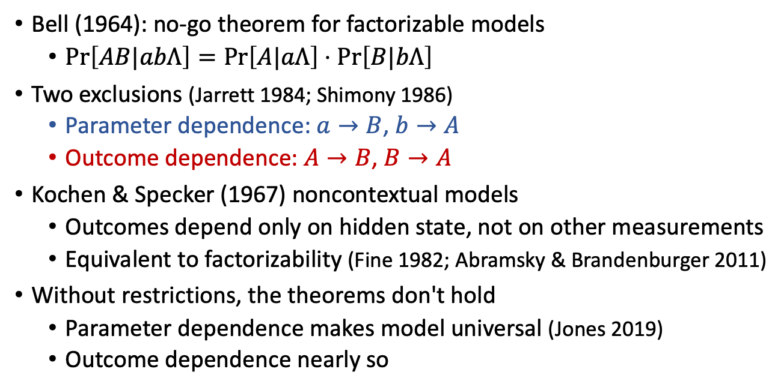




Probabilistic causal foundations of contextuality
hidden state
setting
setting
Bell (1964): no-go theorem for factorizable models
  $\operatorname{Pr}\left[AB|abΛ\right]=\operatorname{Pr}\left[A|aΛ\right]⋅\operatorname{Pr}\left[B|bΛ\right]$
Two exclusions (Jarrett 1984; Shimony 1986)
  Parameter dependence: $a→B$, $b→A$
  Outcome dependence: $A→B$, $B→A$
Kochen & Specker (1967) noncontextual models
  Outcomes depend only on hidden state, not on other measurements
  Equivalent to factorizability (Fine 1982; Abramsky & Brandenburger 2011)
Without restrictions, the theorems don't hold
  Parameter dependence makes model universal (Jones 2019)
  Outcome dependence nearly so
$a$
$Λ$
$b$
A
$B$
outcomes
Notes:
Causality has been always been fundamental to contextuality
The factorizable models that are the subject of Bell’s original theorem embody a causal theory as represented in this graph,
where Alice’s outcome depends only…
The factorizability condition is equivalent to exclusions of two additional causal connections…
A similar situation applies with Kochen-Specker contextuality,
where noncontextual models are defined such that measurement outcomes depend only on the state of the system
and not on what other measurements are made
which is equivalent to a similar factorizability condition by the Fine-Abramsky-Brandenburger theorem

Slide 3






Whence restrictions on causal effects?
$a$
$Λ$
$b$
Theoretical (a priori)
  Relativity and spacelike separation
  Bell and experimental tests
Data-driven (no fine-tuning)
  Causal discovery (Wood & Spekkens 2015, Pearl & Cavalcanti 2021): infer causal separation from empirical independence relations
  $$B⊥a⟹a↛B$$
Both all-or-none
  Apply only to consistently connected systems (no disturbance)
$$×$$
A
$B$

Slide 4
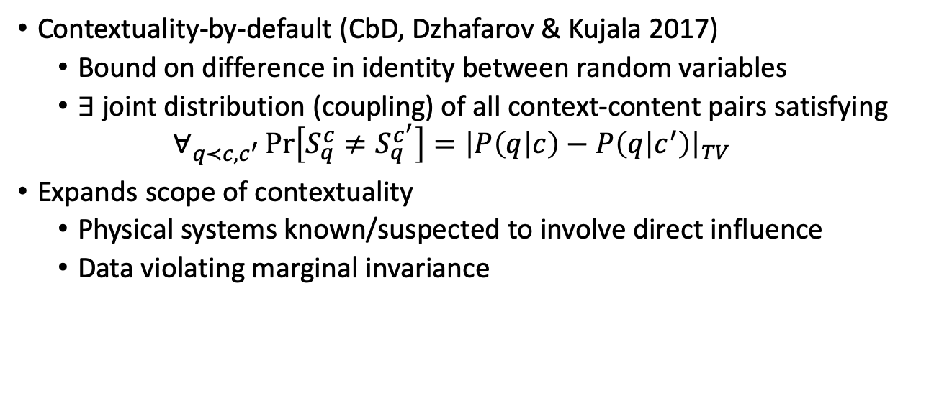
Extended Contextuality
Contextuality-by-default (CbD, Dzhafarov & Kujala 2017)
  Bound on difference in identity between random variables
  $∃$ joint distribution (coupling) of all context-content pairs satisfying
  $$∀_{q≺c,c^{′}}\operatorname{Pr}\left[S_{q}^{c}≠S_{q}^{c^{′}}\right]={\left|P\left(q | c\right)−P\left(q | c^{′}\right)\right|}_{TV}$$
Expands scope of contextuality
  Physical systems known/suspected to involve direct influence
  Data violating marginal invariance
Notes:
CbD defines contextuality according to a bound on how identical the random variables for each observable across different contexts can be
Specifically, a system is CbD-noncontextual if there exists…

Slide 5

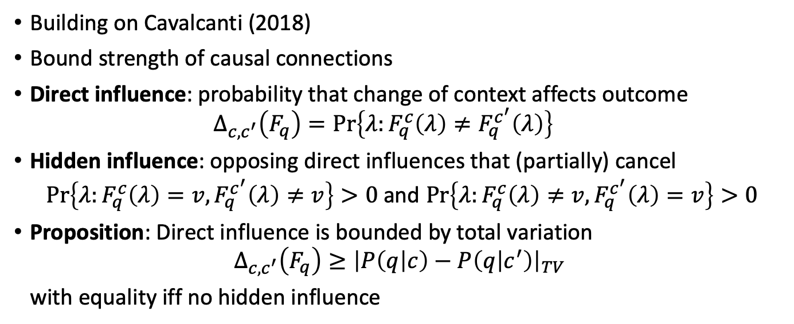





Causal model approach to extended contextuality (Jones 2019)
$C$
$Λ$
$$F_{1}$$
$F_{2}$
$F_{3}$
$F_{4}$
Building on Cavalcanti (2018)
Bound strength of causal connections
Direct influence: probability that change of context affects outcome
  $$Δ_{c,c^{′}}\left(F_{q}\right)=\operatorname{Pr}\left\{λ:F_{q}^{c}\left(λ\right)≠F_{q}^{c^{′}}\left(λ\right)\right\}$$
Hidden influence: opposing direct influences that (partially) cancel
  $\operatorname{Pr}\left\{λ:F_{q}^{c}\left(λ\right)=v,F_{q}^{c^{′}}\left(λ\right)≠v\right\}>0$ and $\operatorname{Pr}\left\{λ:F_{q}^{c}\left(λ\right)≠v,F_{q}^{c^{′}}\left(λ\right)=v\right\}>0$
Proposition: Direct influence is bounded by total variation
$$Δ_{c,c^{′}}\left(F_{q}\right)≥{\left|P\left(q | c\right)−P\left(q | c^{′}\right)\right|}_{TV}$$
with equality iff no hidden influence
Notes:
My work has been aimed at giving a causal-model interpretation to CbD
I’ve followed the causal-models approach developed by Cavalcanti that we saw earlier today,
But instead of limiting which causal connections can be present in a model,
my approach bounds how strong those connections can be
Hidden influences produce causal influences that are stronger than can be observed

Slide 6
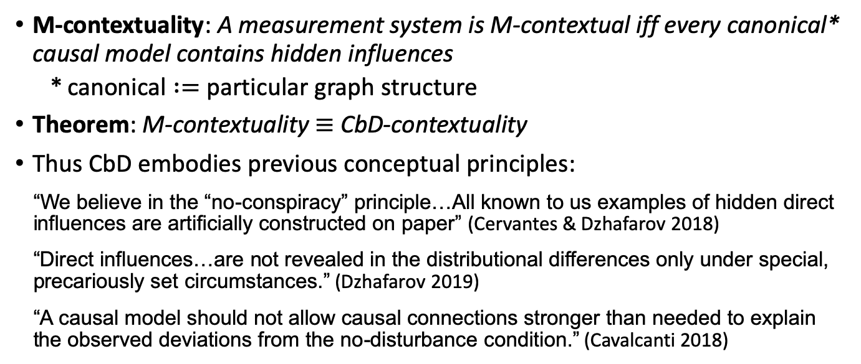
A no-go theorem for extended contextuality
(Jones 2019)
M-contextuality: A measurement system is M-contextual iff every canonical* causal model contains hidden influences
  canonical $:=$ particular graph structure
Theorem: M-contextuality $≡$ CbD-contextuality
Thus CbD embodies previous conceptual principles:
  “We believe in the “no-conspiracy” principle…All known to us examples of hidden direct influences are artificially constructed on paper” (Cervantes & Dzhafarov 2018)
  “Direct influences…are not revealed in the distributional differences only under special, precariously set circumstances.” (Dzhafarov 2019)
  “A causal model should not allow causal connections stronger than needed to explain the observed deviations from the no-disturbance condition.” (Cavalcanti 2018)
Notes:
In that previous paper I defined model-based contextuality as the necessity of hidden influences for modeling a given behavior
and then proved this is equivalent to contextuality as defined in CbD
Canonical refers to a particular structure for the causal graph underlying the model
present goal is to generalize to other structures
This result formalizes principles that have been previously articulated, and proves that CbD-contextuality is a realization of those principles

Slide 7

















Varieties of Causal Models
KS
$C$
$Λ$
Canonical causal models (Jones 2019)
  Context ($C$), outcomes ($F_{q}$), hidden state ($Λ$)
  Causal links: $\left\{C,Λ\right\}→\left\{F_{q}\right\}$
Partitioned models: Split context into settings for observers
Other structures to consider
$$F_{1}$$
$F_{2}$
$F_{3}$
$F_{4}$
Bell
$C$
$Λ$
$a$
$Λ$
$b$
$a$
$Λ$
$b$
$Φ$
$$F_{1}$$
$$F_{2}$$
$$F_{3}$$
$$F_{4}$$
A
$B$
A
$B$
$Φ$
Notes:
In other words, the models extend the standard Kochen-Specker and Bell models by allowing direct effects of context, or what would be called parameter dependence in the Bell setting.
These two representations are equivalent. If we prohibit hidden influences for the grey arrows in either model, we get a definition of noncontextuality that’s equivalent to CbD’s, and also that agrees with Kochen-Specker contextuality when restricted to consistently connected systems.
whole zoo of other graphical structures to consider
Causal connections between observables, intervening hidden variables, and so on
It’s possible that defining contextuality with respect to these other structures will yield different criteria, different extensions of traditional contextuality from the extension given by CbD

Slide 8

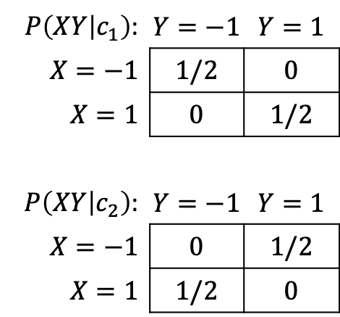

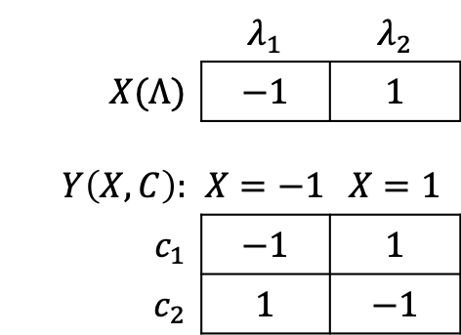

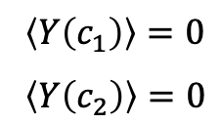

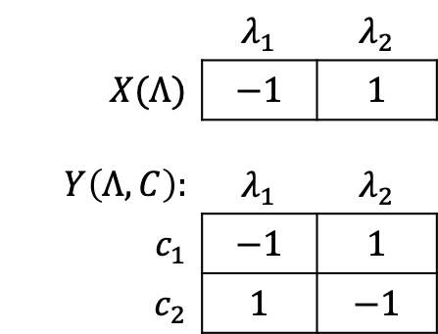


Motivating example
 | $$λ_{1}$$ | $$λ_{2}$$
$X(Λ)$ | $$−1$$ | $$1$$
$$Y\left(Λ,C\right):$$ | $$λ_{1}$$ | $$λ_{2}$$
$c_{1}$ | $$−1$$ | $$1$$
$c_{2}$ | $$1$$ | $$−1$$
$Λ$
$C$
$P\left(XY | c_{1}\right)$: | $$Y=−1$$ | $$Y=1$$
$X=−1$ | $$1/2$$ | $$0$$
$X=1$ | $$0$$ | $$1/2$$
$P\left(XY | c_{2}\right)$: | $$Y=−1$$ | $$Y=1$$
$X=−1$ | $$0$$ | $$1/2$$
$X=1$ | $$1/2$$ | $$0$$
$\left\langle Y\left(c_{1}\right)\right\rangle =0$
$\left\langle Y\left(c_{2}\right)\right\rangle =0$
$$X$$
$$Y$$
 | $$λ_{1}$$ | $$λ_{2}$$
$X(Λ)$ | $$−1$$ | $$1$$
$$Y\left(X,C\right):$$ | $$X=−1$$ | $$X=1$$
$c_{1}$ | $$−1$$ | $$1$$
$c_{2}$ | $$1$$ | $$−1$$
$Λ$
$C$
$$X$$
$$Y$$
Fully
observable
Dzhafarov & Kujala (2016)
Notes:
KS contextuality doesn’t apply here, because there’s disturbance in the joint distribution

Slide 9


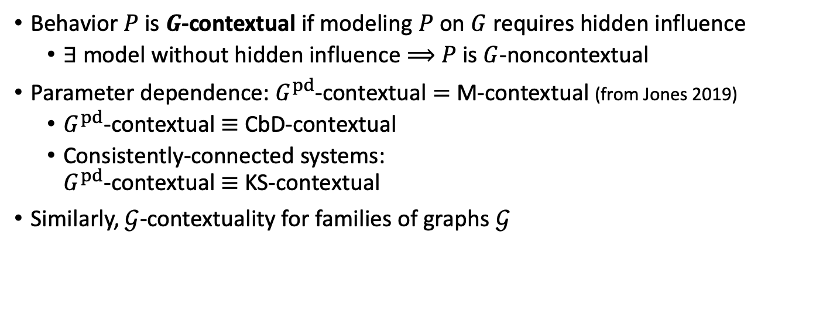

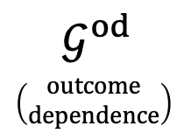










G-contextuality (Graph-based contextuality)
Behavior $P$ is $G$-contextual if modeling $P$ on $G$ requires hidden influence
  $∃$ model without hidden influence $⟹$ $P$ is $G$-noncontextual
Parameter dependence: $G^{pd}$-contextual $=$ M-contextual (from Jones 2019)
  $G^{pd}$-contextual $≡$ CbD-contextual
  Consistently-connected systems:
  $G^{pd}$-contextual $≡$ KS-contextual
Similarly, $𝒢$-contextuality for families of graphs $𝒢$
$$G^{pd}$$
$\left(\begin{matrix}parameter \\ dependence\end{matrix}\right)$
$a$
$Λ$
$b$
A
$B$
$a$
$Λ$
$b$
$a$
$Λ$
$b$
$$𝒢^{od}$$
$\left(\begin{matrix}outcome \\ dependence\end{matrix}\right)$
A
$B$
A
$B$
Notes:
If P cannot be modeled on G at all then G-contextuality is not defined for P
This is at least superficially similar to the fact the KS-contextuality doesn't apply to inconsistently connected systems
For example, we can consider the canonical graph structure I previously analyzed, which I’ll now call G-pd for parameter dependence
Contextuality with respect to G-pd is the same as the model-based contextuality I previously defined
and therefore by my previous theorems, it’s equivalent to CbD contextuality
and for consistently connected systems it’s equivalent to Kochen-Specker contextuality
It’s also useful to make a corresponding definition for families of graphs, for example when we want to consider outcome dependence, since then a graph has to specify the direction of those dependences
In this case we say a behavior is G-contextual if no graph in the family admits a model without hidden influence

Slide 10
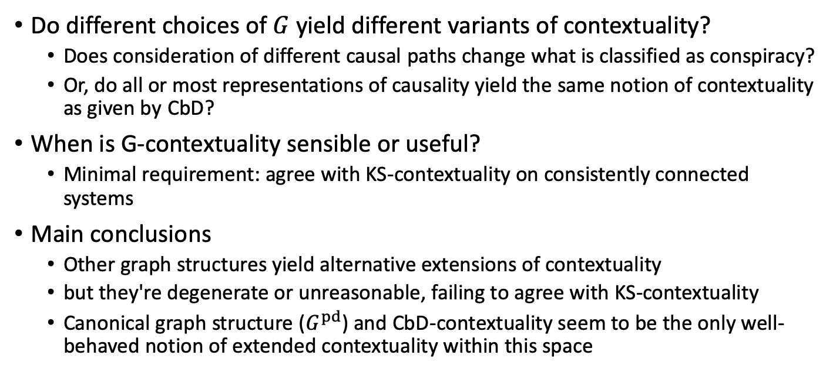
Questions
Do different choices of $G$ yield different variants of contextuality?
  Does consideration of different causal paths change what is classified as conspiracy?
  Or, do all or most representations of causality yield the same notion of contextuality as given by CbD?
When is G-contextuality sensible or useful?
  Minimal requirement: agree with KS-contextuality on consistently connected systems
Main conclusions
  Other graph structures yield alternative extensions of contextuality
  but they're degenerate or unreasonable, failing to agree with KS-contextuality
  Canonical graph structure ($G^{pd}$) and CbD-contextuality seem to be the only well-behaved notion of extended contextuality within this space

Slide 11
Remainder of Talk
Defining hidden influence in arbitrary causal models
Space of possible graphs
Properties of G-contextuality for graphs of interest
Conclusions
Notes:
Now that I’ve laid out the problem and set up the analytical framework, here’s what I’ll do for the rest of this talk

Slide 12


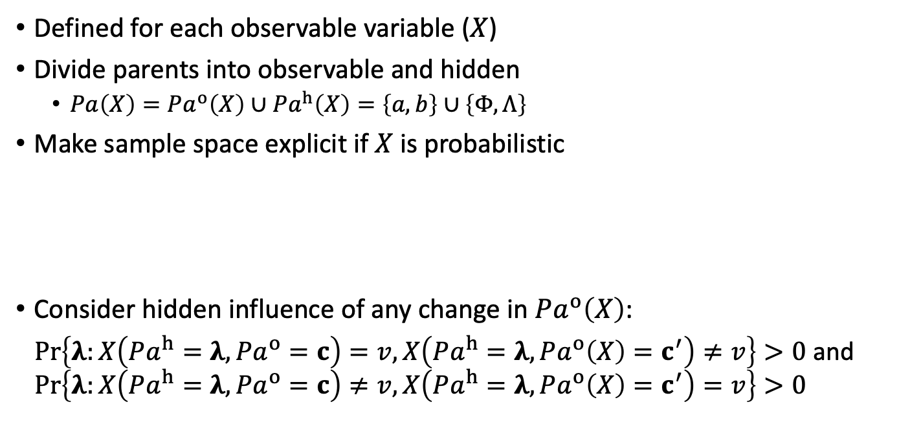











Hidden influence in arbitrary causal models
$Φ$
$a$
$Λ$
$b$
Defined for each observable variable ($X$)
Divide parents into observable and hidden
  $Pa\left(X\right)=Pa^{o}\left(X\right)∪Pa^{h}\left(X\right)=\left\{a,b\right\}∪\left\{Φ,Λ\right\}$
Make sample space explicit if $X$ is probabilistic
Consider hidden influence of any change in $Pa^{o}\left(X\right)$:
$\operatorname{Pr}\left\{λ:X\left(Pa^{h}=λ,Pa^{o}=c\right)=v,X\left(Pa^{h}=λ,Pa^{o}\left(X\right)=c^{′}\right)≠v\right\}>0$ and $\operatorname{Pr}\left\{λ:X\left(Pa^{h}=λ,Pa^{o}=c\right)≠v,X\left(Pa^{h}=λ,Pa^{o}\left(X\right)=c^{′}\right)=v\right\}>0$
X
$Y$
Z
$μ$
$σ$
$μ$
$σ$
$z$
$$z∼𝒩\left(0,1\right)$$
X
$$X∼𝒩\left(μ,σ^{2}\right)$$
X
$$X=μ+σz$$

Slide 13

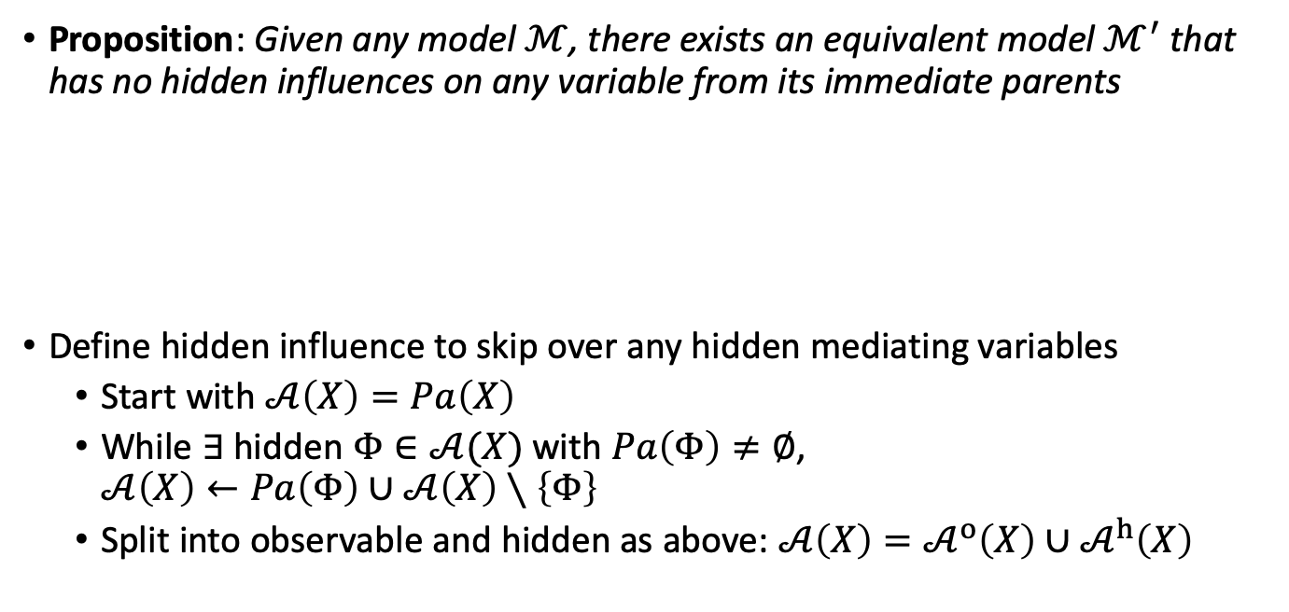







Hidden mediating variables
Proposition: Given any model $ℳ$, there exists an equivalent model $ℳ^{′}$ that has no hidden influences on any variable from its immediate parents
Define hidden influence to skip over any hidden mediating variables
  Start with $𝒜\left(X\right)=Pa\left(X\right)$
  While $∃$ hidden $Φ∈𝒜(X)$ with $Pa\left(Φ\right)≠∅$,
  $𝒜\left(X\right)←Pa\left(Φ\right)∪𝒜\left(X\right)∖\left\{Φ\right\}$
  Split into observable and hidden as above: $𝒜\left(X\right)=𝒜^{o}\left(X\right)∪𝒜^{h}\left(X\right)$
$a$
$Λ$
$a$
$Λ$
$Φ$
$$Φ=\left(a,Λ\right)$$
X
$$X=f\left(a,Λ\right)$$
X
$$X=f\left(Φ_{1},Φ_{2}\right)$$

Slide 14

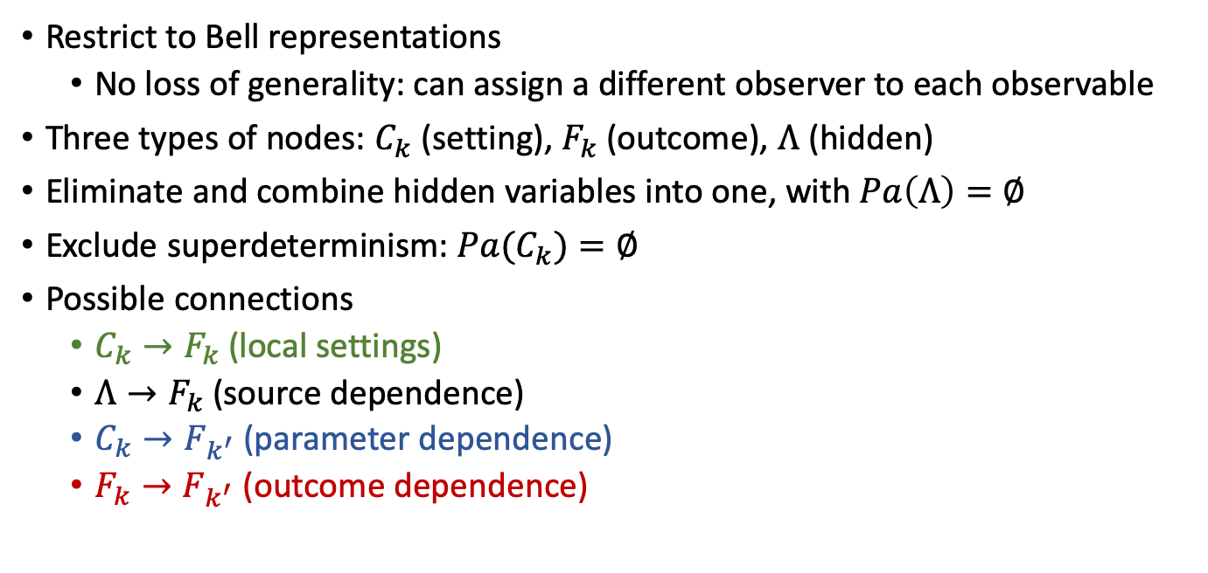






Graph reduction
Restrict to Bell representations
  No loss of generality: can assign a different observer to each observable
Three types of nodes: $C_{k}$ (setting), $F_{k}$ (outcome), $Λ$ (hidden)
Eliminate and combine hidden variables into one, with $Pa\left(Λ\right)=∅$
Exclude superdeterminism: $Pa(C_{k})=∅$
Possible connections
  $C_{k}→F_{k}$ (local settings)
  $Λ→F_{k}$ (source dependence)
  $C_{k}→F_{k^{′}}$ (parameter dependence)
  $F_{k}→F_{k^{′}}$ (outcome dependence)
$C_{1}$
$C_{2}$
$C_{3}$
$F_{1}$
$F_{2}$
$F_{3}$
$Λ$
Notes:
…restrict the space of graphs that we need to consider
First, I’m going to restrict to what I’ve called the Bell representation, meaning graphs where context is decomposed into measurement settings for all observers
There’s no loss of generality since we can assign a different observer to each observable with a dummy measurement whenever that observable isn’t measured
That’s not to say we couldn’t end up with different variants of contextuality using the KS representation
KS representation is tricky: a measurement is sometimes observed and sometimes hidden, depending on context
Collapse over mediating hidden variables as just described, discard ones with no observable descendants, and since the remainder have no parents we can combine them into one composite variable with no parents

Slide 15

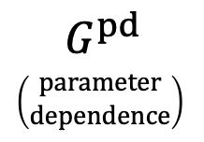







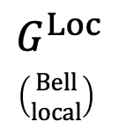
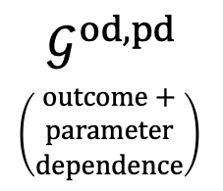














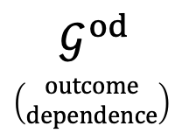











Possible graph structures
$$G^{Loc}$$
$\left(\begin{matrix}Bell \\ local\end{matrix}\right)$
$C_{1}$
$C_{2}$
$C_{3}$
$F_{1}$
$F_{2}$
$F_{3}$
$$G^{pd}$$
$\left(\begin{matrix}parameter \\ dependence\end{matrix}\right)$
$C_{1}$
$C_{2}$
$C_{3}$
KS-contextuality
$Λ$
$$𝒢^{od}$$
$\left(\begin{matrix}outcome \\ dependence\end{matrix}\right)$
$C_{1}$
$C_{2}$
$C_{3}$
$F_{1}$
$F_{2}$
$F_{3}$
CbD-contextuality
(M-contextuality)
$F_{1}$
$F_{2}$
$F_{3}$
$Λ$
?
$Λ$
$$𝒢^{od,pd}$$
$\left(\begin{matrix}outcome+ \\ parameter \\ dependence\end{matrix}\right)$
$C_{1}$
$C_{2}$
$C_{3}$
$$etc.$$
$C_{1}$
$C_{2}$
$C_{3}$
$F_{1}$
$F_{2}$
$F_{3}$
?
$F_{1}$
$F_{2}$
$F_{3}$
?
$Λ$
$Λ$
Notes:
Technically this is a model family, because we have different graphs for the different directions of dependence among the outcomes
And then there’s a whole array of models we can define by allowing only a particular subset of connections of each type, perhaps motivated by considerations of the physical system under study
For example in a Leggett-Garg type scenario that has a temporal ordering to the measurements, we might want to allow dependences only in the forward direction
So then the question is, what variants of contextuality do we get from each of these graphs or graph families?
In the local model, we don’t have to worry about hidden influences because there are no nonlocal influences at all
In the parameter-dependence model, prohibiting hidden influences yields my previous model-based definition of noncontextuality, which is equivalent to CbD’s
But these other families involving outcome dependence are previously unexplored, so it’s these two that I’ll focus on now

Slide 16

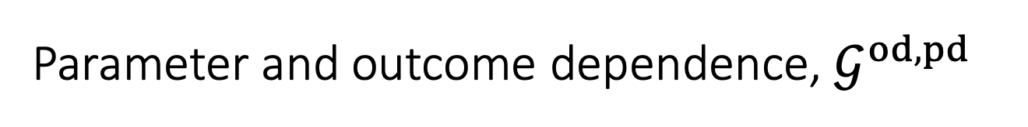




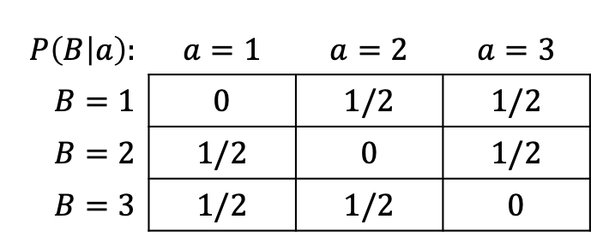
Parameter and outcome dependence, $𝒢^{od,pd}$
Proposition: $𝒢^{od,pd}$-contextuality is strictly stronger than CbD-contextuality
  Stronger: $G^{pd}$ is a subgraph of any graph in $𝒢^{od,pd}$
  Strict: example on next slide
Proposition: $𝒢^{od,pd}$-contextuality is non-empty
$$P\left(B | a\right):$$ | $$a=1$$ | $$a=2$$ | $$a=3$$
$B=1$ | $$0$$ | $$1/2$$ | $$1/2$$
$B=2$ | $$1/2$$ | $$0$$ | $$1/2$$
$B=3$ | $$1/2$$ | $$1/2$$ | $$0$$
$a$
$Λ$
$b$
$\left|A\right|=1$
$\left|b\right|=1$
A
$B$
Adapted from Example 1 of Dzhafarov & Kujala (2017)

Slide 17

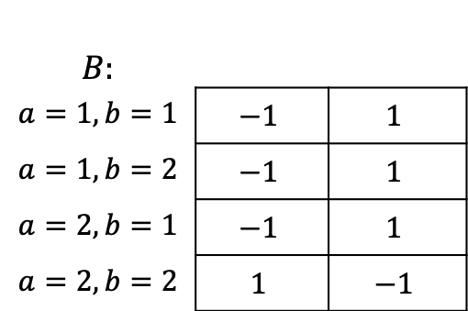


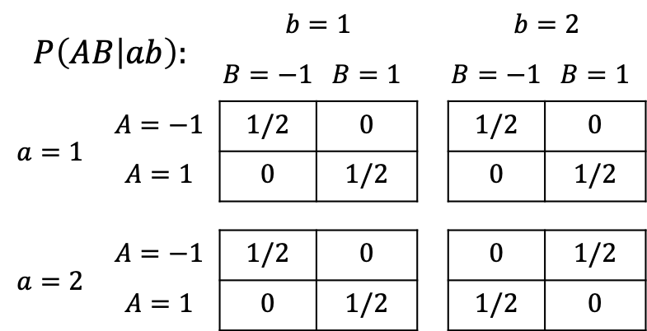

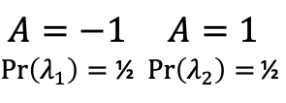

Parameter and outcome dependence, $𝒢^{od,pd}$
Proposition: KS-contextuality does not imply $𝒢^{od,pd}$-contextuality
  PR Box (Popescu & Rohrlich 1994)
$a$
$Λ$
$b$
$$P\left(AB | ab\right):$$ |  | $$b=1$$ |  |  | $$b=2$$
 |  | $$B=−1$$ | $$B=1$$ |  | $$B=−1$$ | $$B=1$$
$$a=1$$ | $$A=−1$$ | $$1/2$$ | $$0$$ |  | $$1/2$$ | $$0$$
 | $$A=1$$ | $$0$$ | $$1/2$$ |  | $$0$$ | $$1/2$$
$$a=2$$ | $$A=−1$$ | $$1/2$$ | $$0$$ |  | $$0$$ | $$1/2$$
 | $$A=1$$ | $$0$$ | $$1/2$$ |  | $$1/2$$ | $$0$$
A
$B$
$$A=−1 \\ \operatorname{Pr}\left(λ_{1}\right)=\text{½}$$ | $$A=1$$ $\operatorname{Pr}\left(λ_{2}\right)=$½
$$B:$$ | $$A=−1 \\ \operatorname{Pr}\left(λ_{1}\right)=\text{½}$$ | $$A=1$$ $\operatorname{Pr}\left(λ_{2}\right)=$½
$$a=1,b=1$$ | $$−1$$ | $$1$$
$$a=1,b=2$$ | $$−1$$ | $$1$$
$$a=2,b=1$$ | $$−1$$ | $$1$$
$$a=2,b=2$$ | $$1$$ | $$−1$$
Notes:
But $𝒢^{od,pd}$ is too flexible
The causal influences on B are fully observable, because it doesn’t depend on the hidden state at all

Slide 18

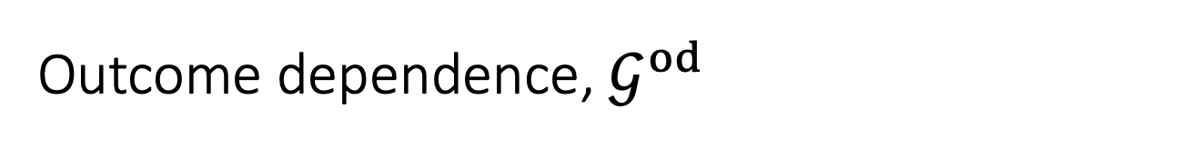



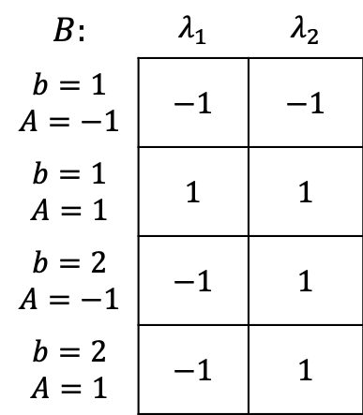

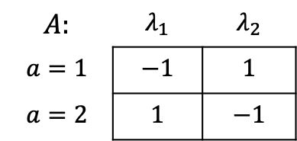
Outcome dependence, $𝒢^{od}$
$a$
$Λ$
$b$
A
$B$
Also too flexible
Proposition: KS-contextuality does not imply $𝒢^{od}$-contextuality
  PR box again:
$$B:$$ | $$λ_{1}$$ | $$λ_{2}$$
$$b=1$$ $$A=−1$$ | $$−1$$ | $$−1$$
$$b=1$$ $$A=1$$ | $$1$$ | $$1$$
$$b=2$$ $$A=−1$$ | $$−1$$ | $$1$$
$$b=2$$ $$A=1$$ | $$−1$$ | $$1$$
$$A:$$ | $$λ_{1}$$ | $$λ_{2}$$
$$a=1$$ | $$−1$$ | $$1$$
$$a=2$$ | $$1$$ | $$−1$$
Notes:
This one is also too flexible
Now B does depend on the hidden state, but that dependence is fully observable in the marginals, so again there’s no hidden influence

Slide 19
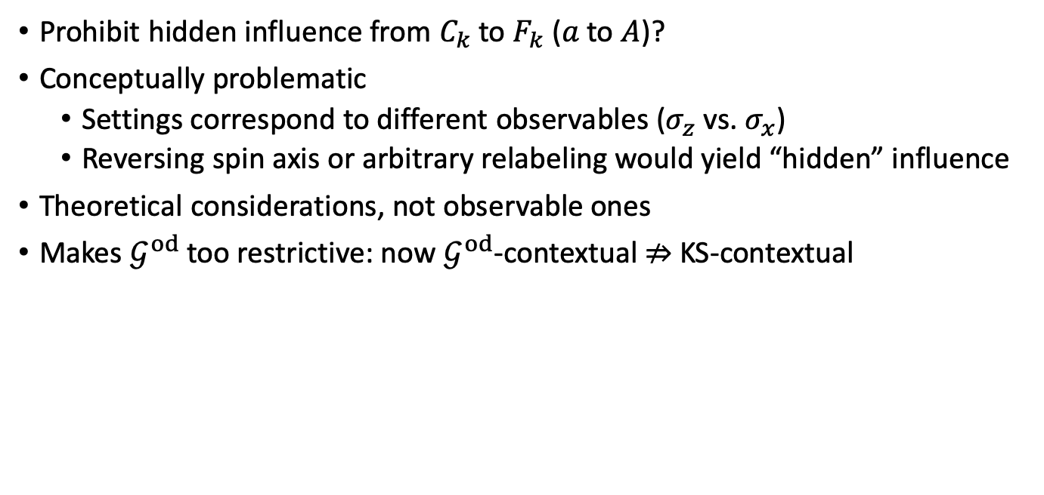
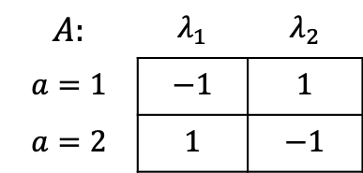
Local hidden influence
$$A:$$ | $$λ_{1}$$ | $$λ_{2}$$
$$a=1$$ | $$−1$$ | $$1$$
$$a=2$$ | $$1$$ | $$−1$$
Prohibit hidden influence from $C_{k}$ to $F_{k}$ ($a$ to $A$)?
Conceptually problematic
  Settings correspond to different observables ($σ_{z}$ vs. $σ_{x}$)
  Reversing spin axis or arbitrary relabeling would yield “hidden” influence
Theoretical considerations, not observable ones
Makes $𝒢^{od}$ too restrictive: now $𝒢^{od}$-contextual $⇏$ KS-contextual
Notes:
Reversing the apparatus: If our result would have been up, now it will be down, and if it would have been down now it will be up
Strictly speaking, these are theoretical considerations and aren’t observable
Thus from a purely operational standpoint it may be plausible to prohibit local hidden influence

Slide 20

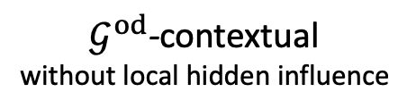

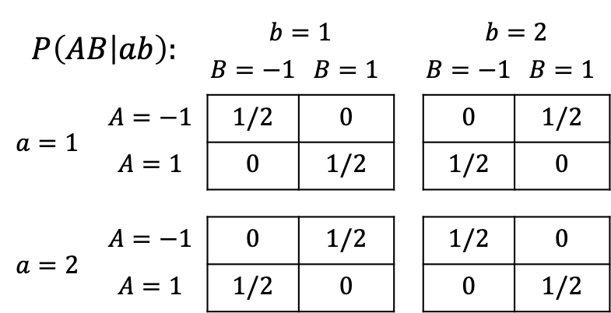
Local hidden influence
Proposition: With local hidden influence prohibited, $𝒢^{od}$-contextuality does not imply KS-contextuality
Prohibiting local hidden influences in $𝒢^{od,pd}$ leaves PR box G-noncontextual
$$P\left(AB | ab\right):$$ |  | $$b=1$$ |  |  | $$b=2$$
 |  | $$B=−1$$ | $$B=1$$ |  | $$B=−1$$ | $$B=1$$
$$a=1$$ | $$A=−1$$ | $$1/2$$ | $$0$$ |  | $$0$$ | $$1/2$$
 | $$A=1$$ | $$0$$ | $$1/2$$ |  | $$1/2$$ | $$0$$
$$a=2$$ | $$A=−1$$ | $$0$$ | $$1/2$$ |  | $$1/2$$ | $$0$$
 | $$A=1$$ | $$1/2$$ | $$0$$ |  | $$0$$ | $$1/2$$
KS-noncontextual Model
$$A_{a_{1}}A_{a_{2}}B_{b_{1}}B_{b_{2}}$$ | $$\operatorname{Pr}\left[A_{a_{1}}A_{a_{2}}B_{b_{1}}B_{b_{2}}\right]$$
$$+1,−1,+1,−1$$ | $$1/2$$
$$−1,+1,−1,+1$$ | $$1/2$$
$𝒢^{od}$-contextual
without local hidden influence
Notes:
This system has a global joint distribution where A1 and B1 are anticorrelated with A2 and B2
But if we deny local hidden influence then this system is G-contextual under outcome dependence
You might also ask what happens when we prohibit local hidden influence in the model with both outcome and parameter dependence
but there we still have the opposite situation where the model is too flexible

Slide 21
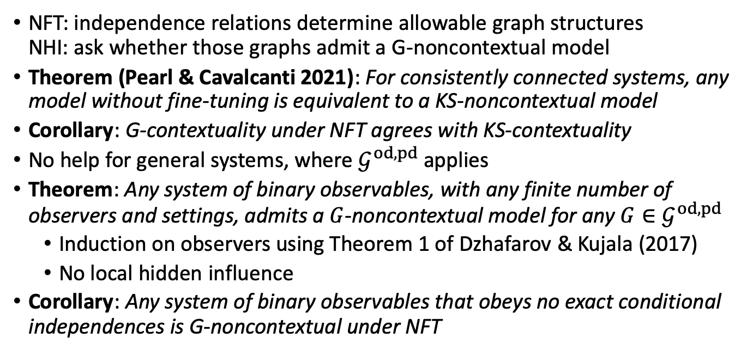
G-contextuality under No Fine-Tuning
NFT: independence relations determine allowable graph structures
NHI: ask whether those graphs admit a G-noncontextual model
Theorem (Pearl & Cavalcanti 2021): For consistently connected systems, any model without fine-tuning is equivalent to a KS-noncontextual model
Corollary: G-contextuality under NFT agrees with KS-contextuality
No help for general systems, where $𝒢^{od,pd}$ applies
Theorem: Any system of binary observables, with any finite number of observers and settings, admits a $G$-noncontextual model for any $G∈𝒢^{od,pd}$
  Induction on observers using Theorem 1 of Dzhafarov & Kujala (2017)
  No local hidden influence
Corollary: Any system of binary observables that obeys no exact conditional independences is G-noncontextual under NFT
Notes:
Finally, I considered whether we could get a useful extension of contextuality by combining the principle of no hidden influences with Cavalcanti’s no fine-tuning principle
In other words, we let the choice of G be determined automatically by the no-fine-tuning principle
One nice feature of G-contextuality under NFT is that it meets my primary criterion of agreeing with KS-contextuality on consistently connected systems
This fact follows from Pearl & Cavalcanti’s theorem…
In general systems where there are no exact conditional independence relations, NFT leaves us with the general graph structure with both parameter and outcome dependence
And it turns out this model is extremely flexible, even with no hidden influence
In particular, if we restrict to binary observables, then there’s a G-noncontextual model of any behavior, for any graph in this family
Theorem 1 of Dzhafarov & Kujala concerning the existence of a multimaximal coupling for any set of binary random variables
Moreover, the construction in the proof yields a model without local hidden influence, so reintroducing that restriction also wouldn’t matter

Slide 22
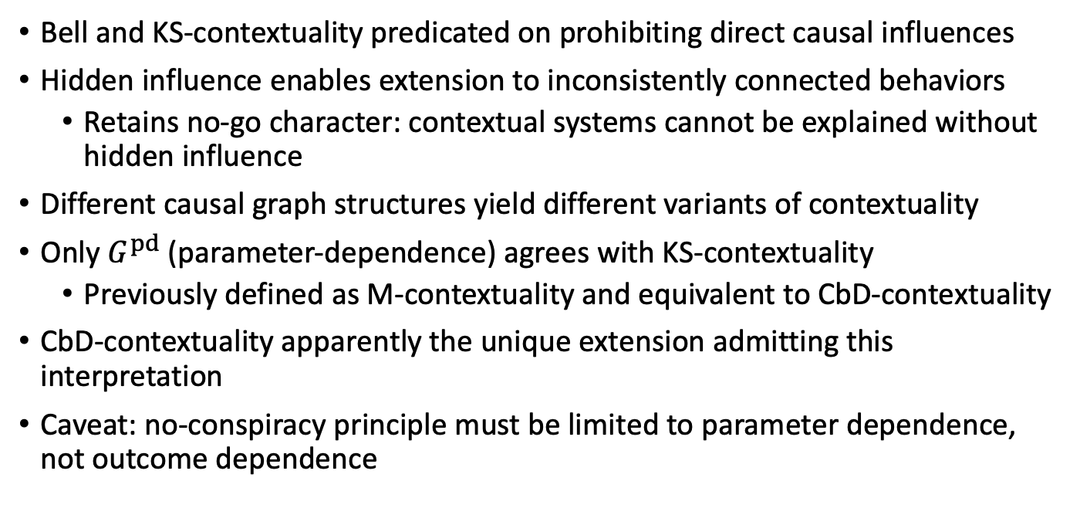
Conclusions
Bell and KS-contextuality predicated on prohibiting direct causal influences
Hidden influence enables extension to inconsistently connected behaviors
  Retains no-go character: contextual systems cannot be explained without hidden influence
Different causal graph structures yield different variants of contextuality
Only $G^{pd}$ (parameter-dependence) agrees with KS-contextuality
  Previously defined as M-contextuality and equivalent to CbD-contextuality
CbD-contextuality apparently the unique extension admitting this interpretation
Caveat: no-conspiracy principle must be limited to parameter dependence, not outcome dependence

Slide 23
References
Abramsky S & Brandenburger A (2011). The sheaf-theoretic structure of non-locality and contextuality. New Journal of Physics, 13: 113036.
Bell JS (1964). On the Einstein Podolsky Rosen Paradox. Physics, 1: 195–200.
Cavalcanti EG (2018). Classical causal models for Bell and Kochen-Specker inequality violations require fine-tuning. Physical Review X, 8: 021018.
Cervantes VH & Dzhafarov EN (2018). Snow Queen is evil and beautiful: Experimental evidence for probabilistic contextuality in human choices. Decision, 5: 193-204.
Dzhafarov EN & Kujala JV (2016). Context-content systems of random variables: The contextuality-by-default theory. Journal of Mathematical Psychology, 74: 11-33.
Dzhafarov EN & Kujala JV (2017). Contextuality-by-Default 2.0: Systems with binary random variables. In J.A. de Barros, B. Coecke, & E. Pothos (Eds.), Lecture Notes in Computer Science 10106: 16-32.
Fine A (1982). Hidden variables, joint probability, and the Bell inequalities. Physics Review Letters, 48: 291.
Jarrett JP (1984). On the physical significance of the locality conditions in the Bell arguments. Noûs, 18: 569–589.
Jones M (2019). Relating causal and probabilistic approaches to contextuality. Philosophical Transactions of the Royal Society A, 377: 20190133.
Kochen S & Specker EP (1967). The problem of hidden variables in quantum mechanics. Journal of Mathematics and Mechanics, 17: 59–87.
Leggett AJ & Garg A (1985). Quantum mechanics versus macroscopic realism: Is the flux there when nobody looks? Physical Review Letters, 54(9): 857–860.
Pearl JC & Cavalcanti EG (2021). Classical causal models cannot faithfully explain Bell nonlocality or Kochen-Specker contextuality in arbitrary scenarios. Quantum.
Popescu S & Rohrlich D (1994). Quantum nonlocality as an axiom. Foundations of Physics, 24(3): 379–385.
Shimony A (1986). Events and processes in the quantum world. In Quantum Concepts in Space and Time, R. Penrose and C.J. Isham (eds.), Oxford: Oxford University Press, 182–203.
Wood, C. J., & Spekkens, R.W. (2015). The lesson of causal discovery algorithms for quantum correlations: Causal explanations of Bell-inequality violations require fine-tuning. New Journal of Physics, 17: 033002.

